Slide 1
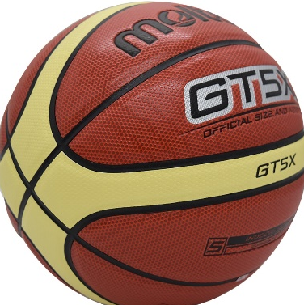
GS GA WA C WD GD GK
Year 8&9
Term 1 + 2
Umpire
Captain
Communication
Footwork
LEAD A WARM UP
Teamwork
Netball Hockey
Free Pass
Penalty Pass
Loud Voice
Substitution
Offside
Contact
Free Throw
Red Card
Foul
Offside
Goal kick
Enthusiasm
Free Kick
LEAD A COOL DOWN
Basketball
Football
Yellow Card
Double
Dribble
Captain
Well Prepared
Umpire
Referee
Court
Foul
Referee
Penalty
Confidence
Lineout
Obstruction
LEAD A DRILL
Rugby
Excellent Knowledge
Foul Play
Touch Judge
Official
Offside

Slide 2
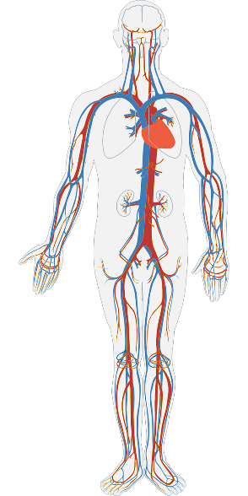
Counterbalance
Straddle
Year 8&9
Term 3 + 4
Referee
Foul
Awareness
Forward Roll
Travel
Goal Throw
MOTIVATION
Gymnastics
Double Dribble
Passion
Cartwheel
Apparatus
Balance
Tuck
Pike
Sequence
Handball
Good Motivator
Circuits
Treadmill
Penalty
Weight Training
Free Throw
Health
Related Fitness
Block
COMMUNICATION
Effectiveness
Heart Rate
Cardiovascular Endurance
Training Methods
Effects of Exercise
Straight Jump
Front Drop
Consistency
Swivel Hips
Trampolining
KNOWLEDGE
Somersault
Decision Making
Seat Drop
½ Turn
Back Drop
Full Turn

Slide 3
1500m
Warm Up Characteristics
Year 8&9
Term 5 + 6
High Jump
Long Jump
Hurdles
ENTHUSIASM
Athletics
Javelin
Shot Putt
Triple Jump
Cool Down Characteristics
800m
Sprint
Relay
½ Rounder
Base
Obstruction
Batter
Lead a Plenary
CONFIDENCE
Fielder
Rounders
Pull shot
Drive
Cut shot
Bowler
LBW
No Ball
Innings
Questioning
Teamwork
1 Rounder
Cricket
Backstop
Foul Ball
Fielding positions
Seam bowling
Overthrow
Base
Spin bowling
Softball
PERSONALITY
Lead a whole group activity
Inning
Pitcher
Strike Out
Obstruction

