Slide 1
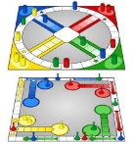
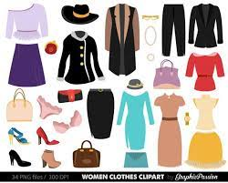
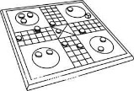
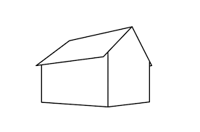
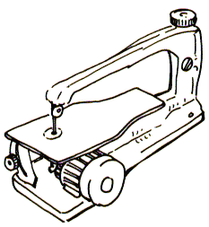
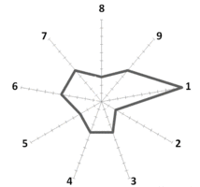
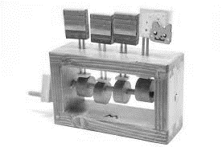
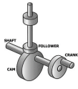
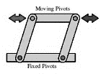
Applied Revision Methods & Exam Techniques
GCSE Design & Technology
Curriculum Map
FE College courses
Grimsby, Lincoln
Trades e.g. Electrician, Plumbing, Mechanical Engineering
NVQ – Fashion Design
JSTC
A Levels?
BTECs?
Apply for post-16 option(s)
Post-16 Options
A Level Engineering
A Level Product Design
A Level Design Technology
Coursework = 50%
EXAMS
Examination = 50%
Examined
Assessment
(Completion)
Manufacturing skills
CAD design
None Examined
Assessment
(Evaluation)
Forming
2 Point
Perspective
Isometric
Drawing
Sustainability
Design Maths
Tools
Renewable Energy
None Examined Assessment
(Manufacture)
None Examined Assessment (Designing)
None Examined Assessment (Research)
YEAR
11
Life Cycle Analysis
Standard
Components
Upcycling
Market Research
Product Specification
Design Ideas drawing
Product Evaluation
None Examined Assessment
Theme release – June 1st
Papers & Boards
Product modifications
Fixings
Machines / tools
Timber properties and sources
Research Analysis
Specialist Exam
Content
Skills & knowledge development (mini project)
Skills & knowledge development
Design Brief
Manufacture
Quality Assembly
Accuracy of finish
Mechanisms
3D Printing
Iterative Design
Marking out
Risk assessment
Laser cutting
Core
Exam
Content
Wasting techniques
Hand tools
Making
Card engineering & outputting design data using laser cutters / CNC vinyl cutters
Course intro
Evaluation
Evaluation & Testing against criteria
Designing
Using other cultures
YEAR
Making
NET shapes – scoring – card forming Styrofoam modeling
10
Graphics
Skills building
Manufacturing
Table Top Game
Technical Drawing
CAD / 2D & 3D – isometric orthographic projection
Technical Principles
NET shapes – rendering –
3D printing
Designing
Skills building - Sketch development - 2D and 3D CAD. 2D and 3D hand drawing.
Graphics
Table Top Game -Designing
Evaluation
Product
Analysis – Self / peer assessment
Making
Use of laser cutting– vacuum forming – strip heater –
Cutting mat and Craft knife
Materials
Investigating graphic materials - properties - uses - costings - manufacture – sustainability.
Designing
Typography
Making
Templates / net shapes
2D and 3D drawing techniques
Designing
Using the influence of others work
Making
(One off – batch - mass production) Use of specialist hand tools – focus on accuracy
Technical Principles
Specific CAD tools – CAD CAM
Designing
CAD – Google-sketch-up / MS Word
Technical Drawing
Isometric
Oblique
Rendering different materials
Designing
Using the influence of past & present designers
Making Skills Building
1:1 scale prototype model.
Laser cutting
CNC vinyl cutting.
Hand making techniques – marking out – cutting and forming of materials.
Safe and effective selection and use of workshop tolls and machines
Research
Existing designs for different users / markets
Engineering Module
Textiles Module
Graphics Module
YEAR
YEAR
Food Module
9
GCSE D&T Option Choice
8
Papers & Boards (Graphics) option only;
Note: Textiles is not an option choice past year 8
Research
Product Analysis
Research
Client needs / Brief and specification
Designing
CAD – Google-sketch-up
Evaluation
Evaluate products against a criteria
Technical Principles
Properties of plastics, Timbers & Metals
Making (Production)
Marking out / use of Jigs
Designing
Computer aided design (CAD) Google-sketch-up / MS Word
Modelling
Technical Principles
Sustainability
Technical Principles
Sustainability / renewable energy
Designing
Using CAD (MS Word Vs isometric rendered drawing
Making
Using power tools & machines / laser cutting
Research
Existing Products User needs
Making
Using tools & equipment
Designing
Form and Function
YEAR
Food Module
Textiles Module
Graphics Module
Engineering Module
7
Making (Planning)
Plan of making
Designing
Design creatively / shading Techniques
Using biomimicry
Technical Principles
Properties of plastics & Timbers
Designing
Ergonomics / Anthropometrics
Technical Drawing
Oblique
Isometric

