Slide 1
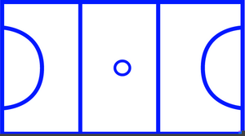
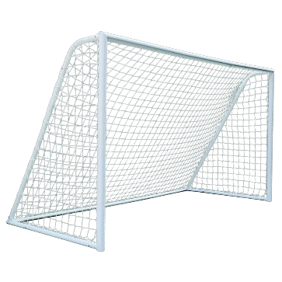
GS GA WA C WD GD GK
Year 7
Term 1 + 2
Passing
Footwork
Coordination
Umpire
Components of Fitness
Netball
Quarters
Teamwork
Muscular Strength
Goal
Circle
Shooting
Dribbling
Agility
Backboard
Components of Fitness
Outwitting Opponents
Basketball
Attacker
Free Kick
Referee
Aerobic Endurance
Free Throw
Double
Dribble
Travelling
Football
Try
Tackling
Goalkeeper
Pitch
Power
Rucking
Touchline
Offside
Defender
Components of Fitness
Rugby
Muscular Endurance
Backwards Pass
Mauling

Slide 2
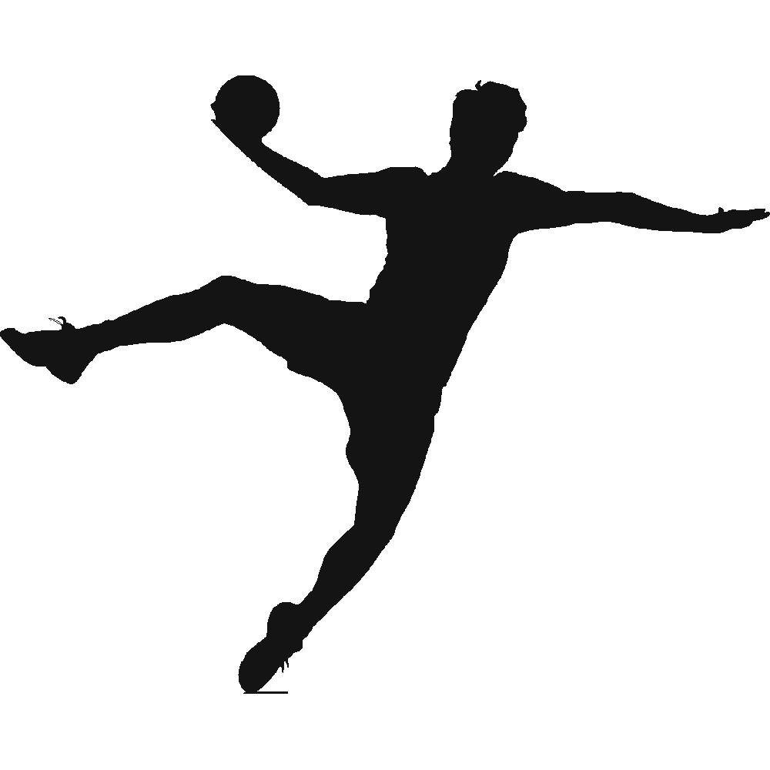
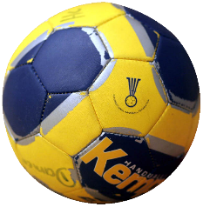
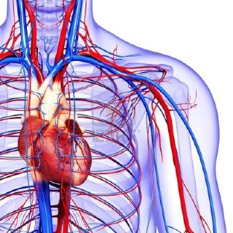
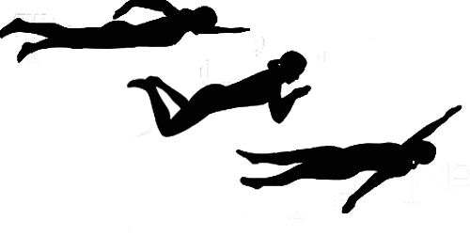
Counterbalance
Straddle
Balance
Forward Roll
Year 7
Term 3 + 4
Travel
Components of Fitness
Gymnastics
Shooting
Attack
Dribble
Cartwheel
Balance
Flexibility
Apparatus
Tuck
Pike
Sequence
Handball
Muscular Strength
Circuits
Treadmill
Goalkeeper
Weight Training
Free Throw
Health
Related Fitness
Goal Area
Components of Fitness
Control
Agility
Heart Rate
Cardiovascular Endurance
Training Methods
Effects of Exercise
Crawl
Float
Free style
Aerobic Endurance
Breaststroke
Backstroke
Components of Fitness
Swimming
Lifeguard
Coordination
Butterfly
Tread Water

Slide 3
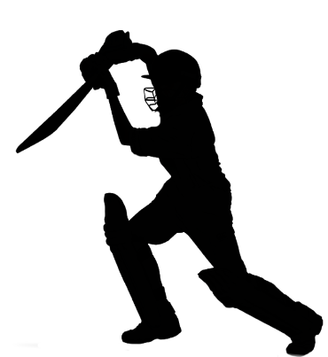
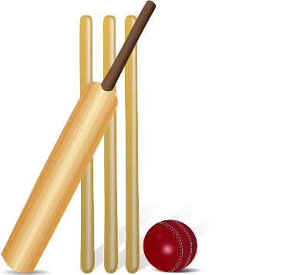
1500m
High Jump
Long Jump
Year 7
Term 5 + 6
Hurdles
Speed
Components of Fitness
Athletics
Javelin
Shot Putt
Triple Jump
Reaction Time
800m
Sprint
Relay
½ Rounder
Base
Obstruction
Batter
Coordination
Components of Fitness
Fielder
Rounders
Wicket Keeper
Batsman
Run-out
Bowler
LBW
Muscular Endurance
No Ball
Innings
Teamwork
1 Rounder
Cricket
Backstop
Break Point
Volley
Advantage
Bowler
Power
Fielder
Backhand
Stumps
Components of Fitness
Tennis
Aerobic Endurance
Forehand
Lob
Court
Rally
Ace
Serve
Deuce

