Slide 1
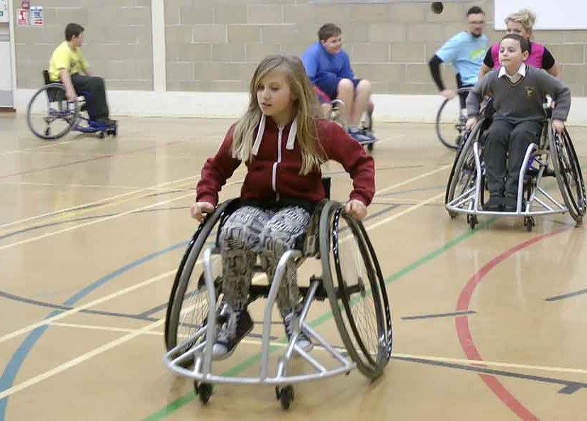
OCR Cambridge National – Sport Studies – R051 Contemporary issues in sport – LO1
Different user groups – A range of people participate in sport, many face barriers that restrict usage.
 | Barriers to participation Lack of disposable income: The amount of money people have available. Lack of time: Some jobs leave very little free time to take part in sport. Commitments: Family or job related leaves very little time for sport. Accessibility: Good public transport links, disabled access and parking means more people can access. Provision of activities: Local areas will offer different activities depending on location and surroundings. Awareness: Advertising and promotion is how we are made aware of the offering in an area. Lack of role models: Known people that others aspire to be like. Stereotyping: Viewpoints about an idea or a particular type of person. | Solutions to the barriers faced Promotion of positive role models. Increased media coverage. Improved accessibility. Increased provision of suitable activities. Subsidised costs (reduced rate covered by government) Targeted campaigns to engage users.
Popularity of sport in the UK can be impacted by:
User group | Details
Ethnic minorities | A group within a community with a different culture, religion or nationality. i.e. Black, Asian or Arabic.
Retired people/ people over 50 | You can retire from work at any age. Most retired people received a state pension.
Families with young children | Raising young children requires a great deal of care often 24/7.
Single parents | This is any adult bringing up a child on their own.
Children/teenagers | A child is anyone under the age of 18. Teenagers are classified by the ages of 13 to 19.
Disabled | Physical or mental conditions that affect their ability to carry out movement. i.e. Visual, hearing, autism or a physical disability.
Unemployed/ economically disadvantaged | Unemployed = no job. Economically disadvantaged = not enough income to meet basic needs.
Working singles and couples | Individuals who work and struggle to find the time to participate in sport.
1. Participation:
Sports with widespread mass participation remain popular. Walking for leisure, football due to strong infrastructure and upcoming activities such as cycling.
2. Success for individuals and teams:
Positive outcomes during high profile events causes an increase in popularity. Gymnastics after Rio 2016.
3. Spectatorship/media coverage:
Some sport channels are available 24/7. Spectators viewing sports can be inspired to participate.
4. Role Models:
Sports with limited role models suffer from a lack of interest. Positive role models inspire future generations. i.e. Netball
5. Provision/Environment:
Access to the necessary facility, specialist equipment or coaching is required. Specific natural environments not found in the UK are often man made. i.e. skiing.
6. Acceptability:
Some sports are seen as less acceptable especially if they involve violence or cruelty to animals. i.e. boxing.
@PEResourcesbank

Slide 2
OCR Cambridge National – Sport Studies – R051 Contemporary issues in sport – LO1
Key term | Definition/notes/concept
Exam Questions:
1. Many parents and teachers are concerned that teenagers do not participate enough in physical activity. Give three possible barriers which can prevent teenagers from regular participation in physical activity and sport. (3)
2. Give three factors, other than environment and climate, which can have an impact upon the popularity of sport in the UK. (3)
3. Tom is 66 years old and his partner Caroline is 59. Tom is retired but Caroline still works full-time. They only have one car. Both would like to get fitter by playing more sport. Describe two barriers to Tom’s participation in sport and two possible solutions. (4)
@PEResourcesbank

