Slide 1
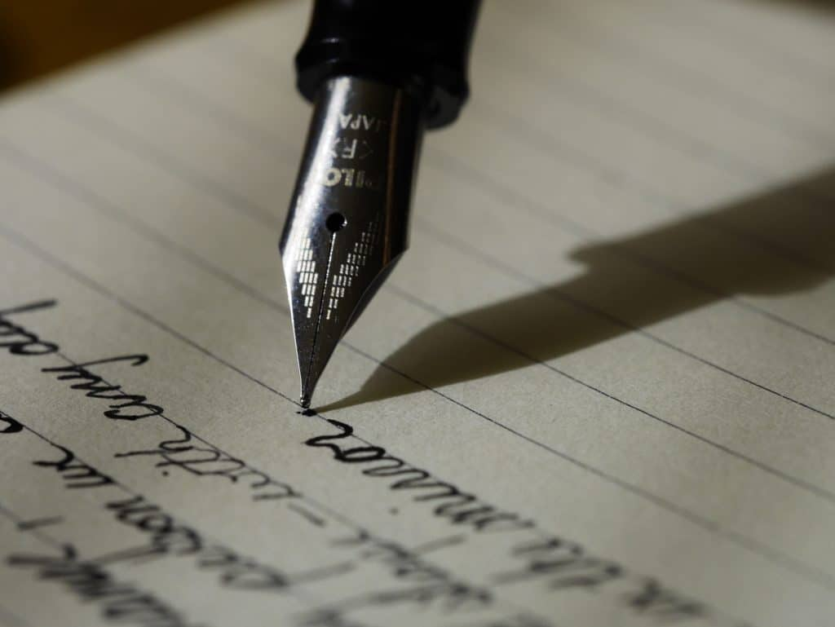
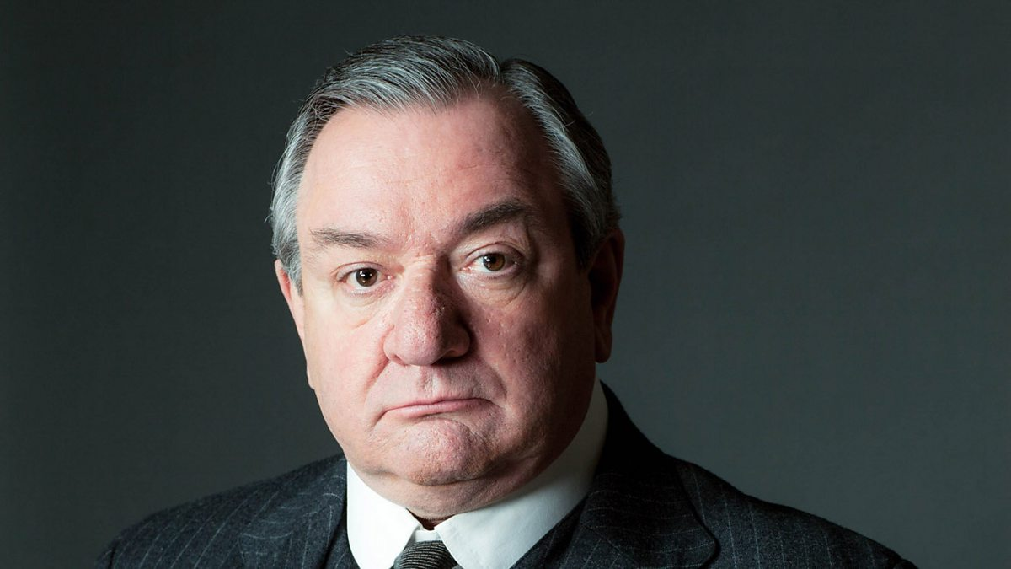
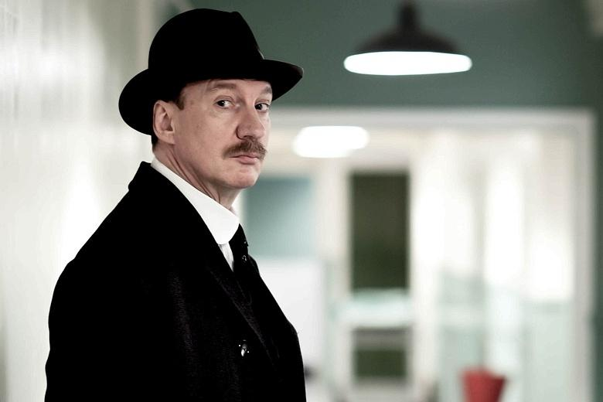
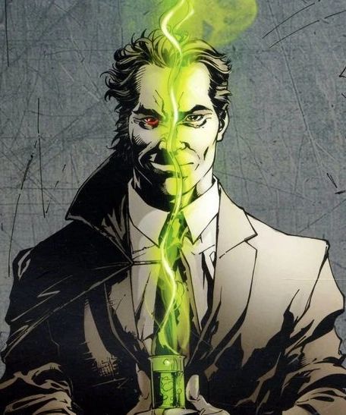
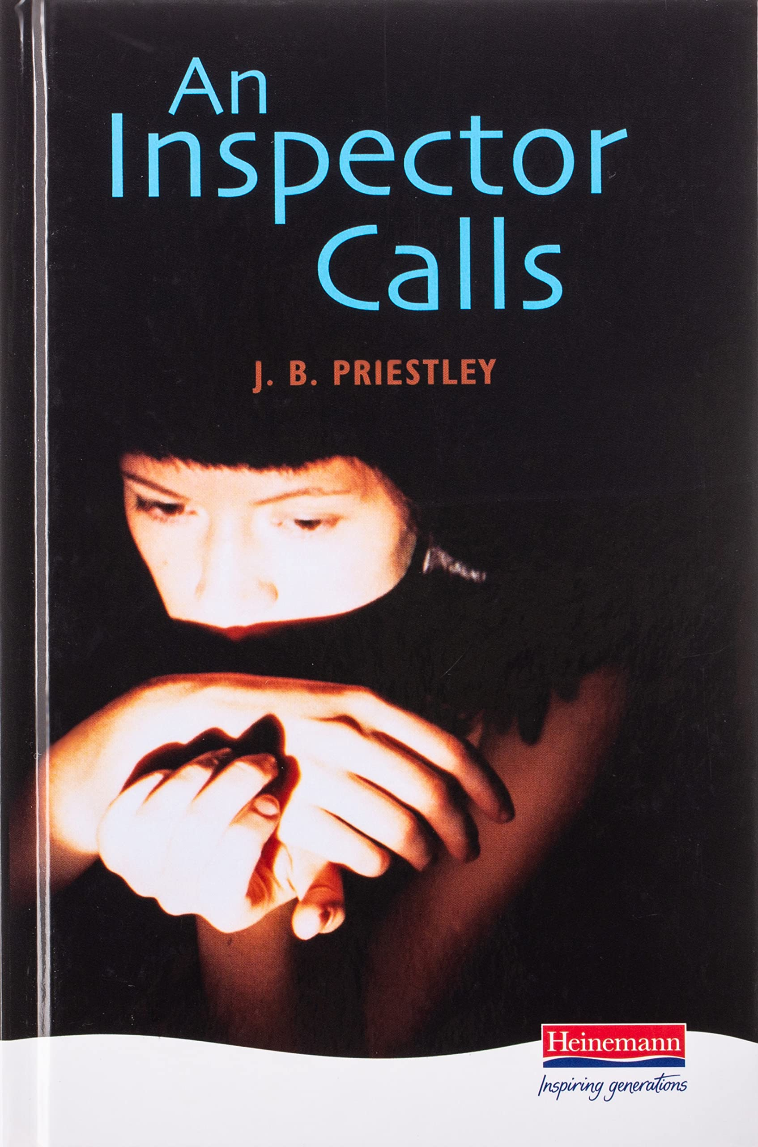
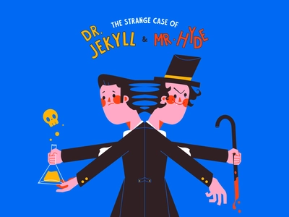
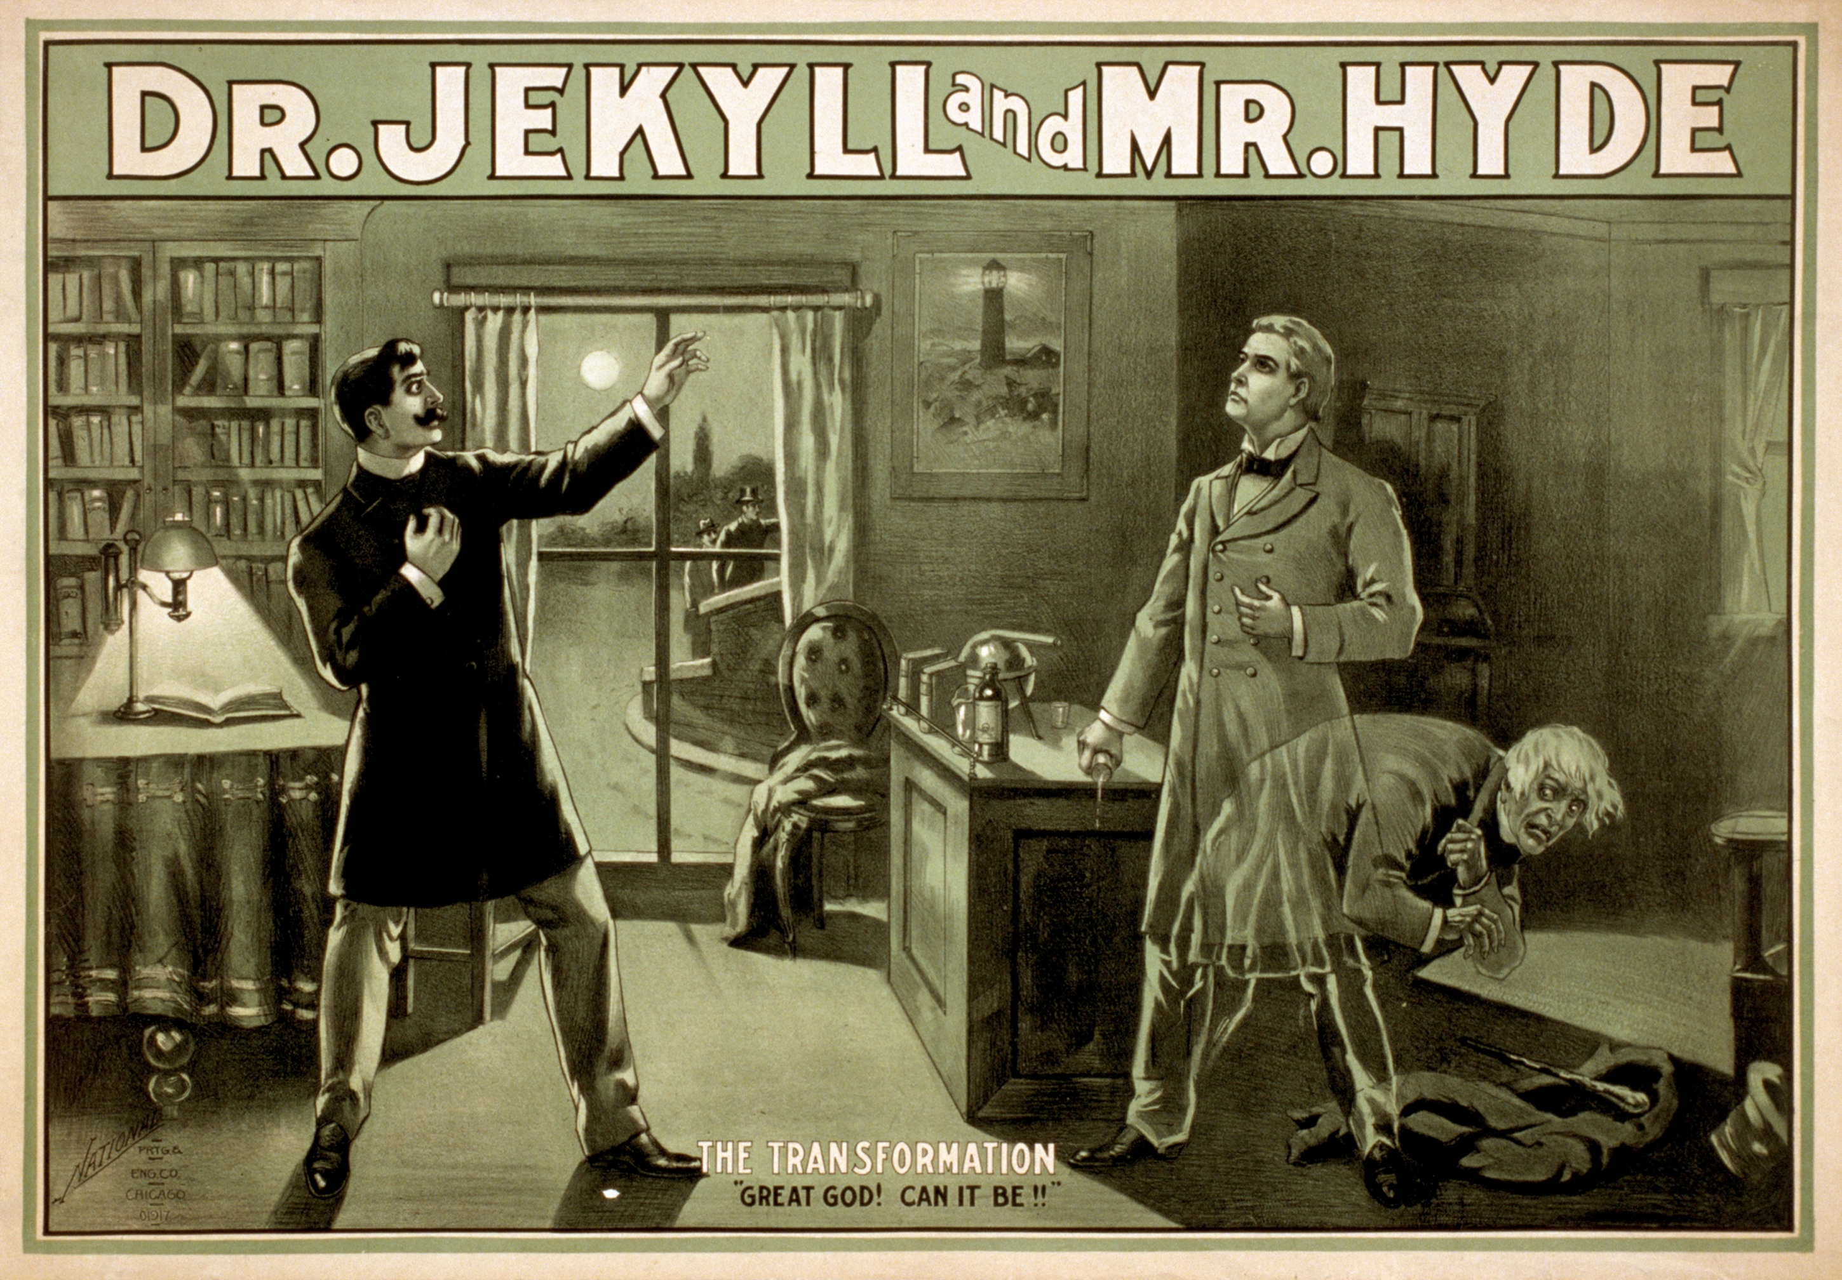
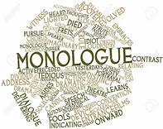
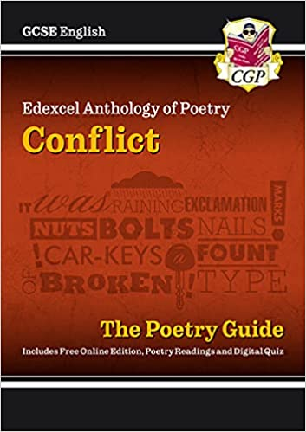
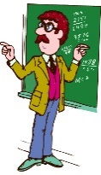
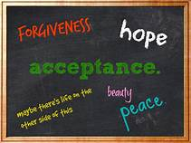
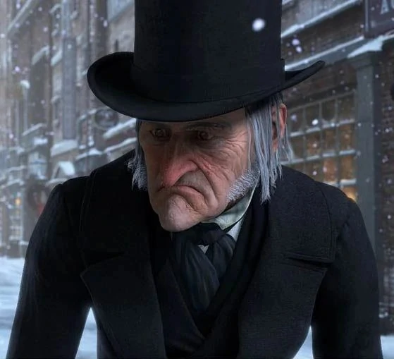
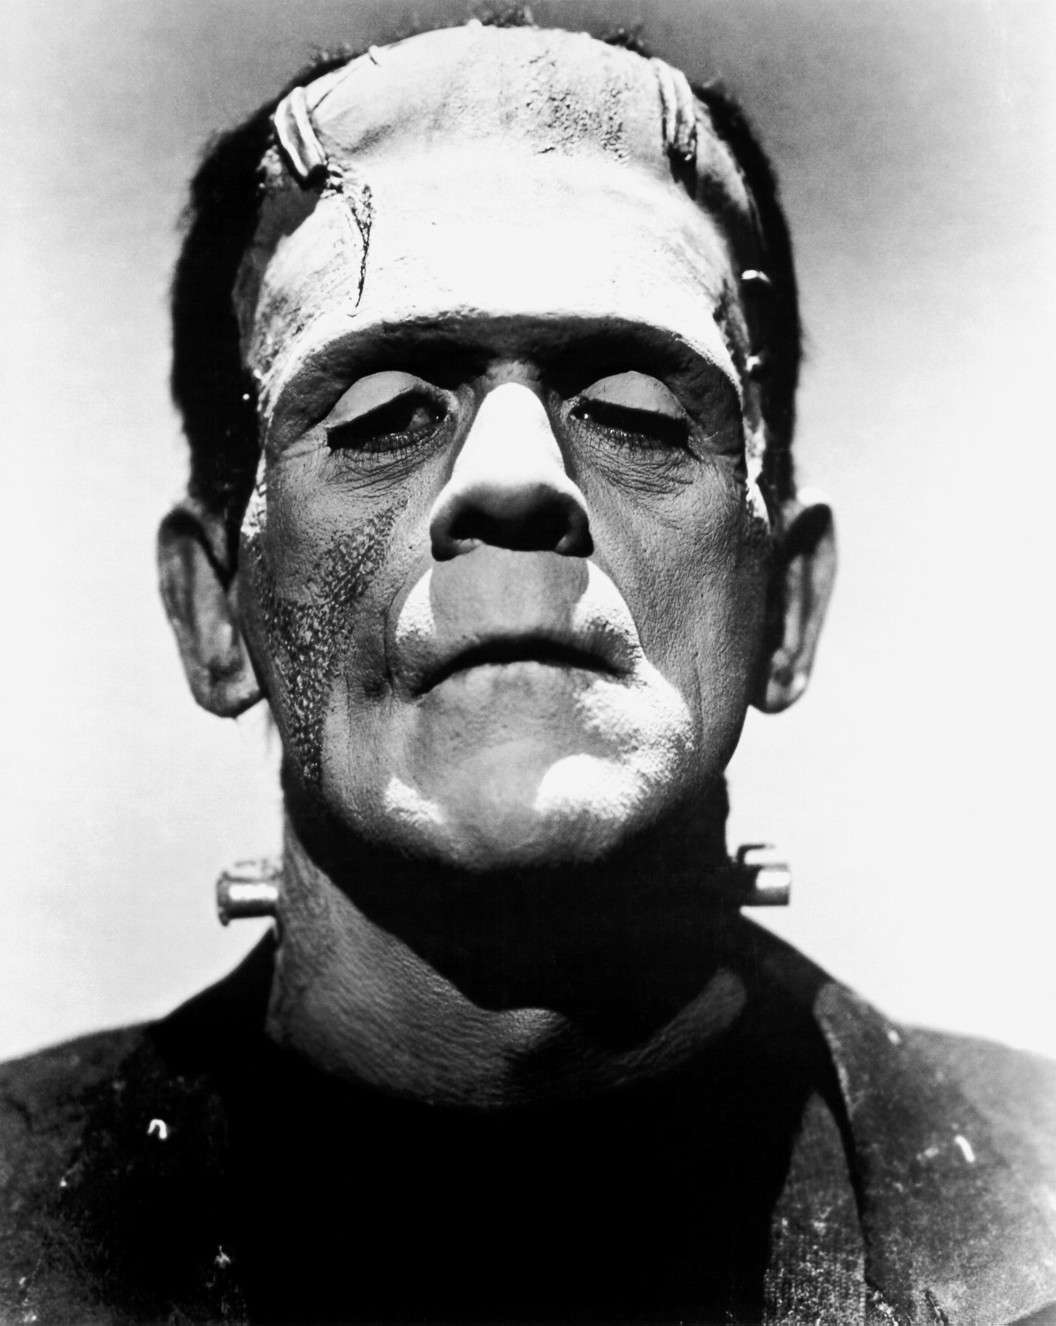
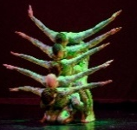
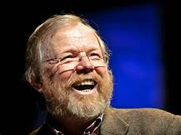
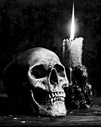
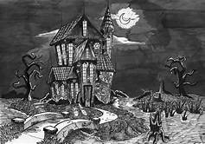
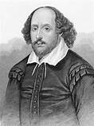
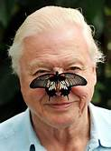
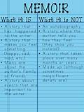
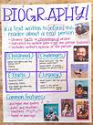
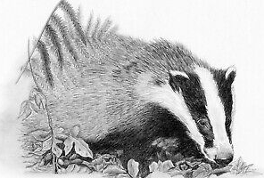
Independent and Imaginative Thinkers
Contextualisation / Themes
Knowledge and Texts
AOs
JSTC English Department: English Literature
Five Year Learning Journey
Student Reflection:
How am I preparing for my English Literature GCSE? Am I attending revision sessions or making time during independent learning time to adequately prepare?
Progression to next stage of learning:
A Level Scriptwriting
A Level English Literature
A Level Drama and Theatre Studies
‘Student Focused Preparation. 10 Week Countdown’
GCSE PAPER 1 & 2
MOCK EXAM
Personal Development
Reflection
Confidence
An Inspector Calls/Refugee Boy; Romeo and Juliet, Dr Jekyll and Mr Hyde, Conflict Poetry, Unseen Poetry
Student Reflection:
How will I ensure that the choices I make in Y11 will support my academic development?
‘An Inspector Calls’
GCSE PAPER 1
SLE to be completed on a topic of choice. Class teachers may guide students to complete on a Literature text
Honesty
Bravery
Confidence
Assessment Mock Feedback will be conducted in a whole department style following the Mock Exams
AO1, AO2, AO3, MOCK EXAM
AO7, AO8, AO9
‘Dr Jekyll and Mr Hyde’
GCSE Paper 2
‘Dr Jekyll and Mr Hyde’
GCSE Paper 2
11
Playwright techniques
Assessment Question: Students will complete an extract question from Dr Jekyll and Mr Hyde – Hyde as Frightening Outsider
Assessment Question: Paper 1 Romeo and Juliet / Paper 2 Dr J and Mr H
Chapter 2;
Chapter 7
Control
Resilience
Reflection
Confidence
Courage
Curiosity
Respect
Feedback
AO1, AO2, AO3 MOCK EXAM
Introduction to the English Literature specification and how this is underpinned by specific AOs
Act 3, Scene 1;
Act 1, Scene 2;
Act 3, Scene 5
‘Romeo and Juliet / Poetry’
GCSE PAPER 1 / 2
10
‘Romeo and Juliet / Poetry’
GCSE PAPER 1 / 2
Personal conflict
Inner emotion
SLE Opportunities: Spoken Language Practice
Students should begin developing a spoken piece for the SLE. Monologue workshop appropriate here
Confidence,
Personal Management
Resilience
AO1, AO2
19th Century Literary Fiction
Pearson Pioneer Project: Refugee Boy.
SLE Opportunity: Acceptance
Students to practice speech writing and performances through explicit Literature teaching
Reflection
Deliberation
Respect
Assessment Question: Students to complete assessment post teaching of this new GCSE text
‘Lit in Colour’
GCSE PAPER 1
Reflection
Kindness
Hope
19, 20, 21 Century Literary Non Fiction
AO1, AO2, AO3
‘Diversity, Difference and Acceptance’
INTRODUCTION
‘Diversity, Difference and Acceptance’
MASTERY
9
SLE Opportunity: Good or Bad?
A review of a selected Literary Non Fiction text.
AO1, AO2, AO3
‘Fantastic Adventures’
MASTERY
Livingstone; Pole to Pole; Bryson
Social and Historical context
Assessment Question: Studying Non Fiction texts / Literary Non Fiction
Solidarity
Compassion
Diversity
Difference
Assessment Question: Frankenstein AO1, AO2
AO1, AO2, AO3
Tell Tale Heart; Great Expectations; A Christmas Carol
Exploration of culture
‘Fantastic Adventures’
INTRODUCTION
History – 19th Century Britain
Trust, confidence,
self control
‘Tales of Terror’
MASTERY
Non Fiction texts
SLE Opportunity: To fear or not to fear!
Students to devise a frightening narrative and share with their peers – adopting tone, style and register
Love of learning
Sense of humour
Theatre Play
Confidence
Introduction to Elizabethan audiences and societal difference
AO1, AO2 Narrative Structure
‘Tales of Terror’ INTRODUCTION
Determination
Compassion
Integrity
Trust
Modern VS Elizabethan
Introduction to Drama
‘Natural Wonder’
MASTERY
AO1, AO2, AO3
‘Shakespeare’s Magic’ INTRODUCTION
‘Shakespeare’s Magic’
MASTERY
8
Assessment Question: Analysis of ‘The Sea’
Overcoming fear
Bravery
Resilience
Acceptance
The Badger;
The Vixen;
Private Peaceful;
My Family and Other Animals
‘Natural Wonder’ INTRODUCTION
SLE Opportunity: Students to have the opportunity to speak to an audience about their chosen poem and its key theme.
Assessment Question: The Tempest / Macbeth
Elizabethan Language
Assessment Question: Baseline measured through English Language
Trust
Bravery
Challenge
Determination
AO1, AO2,
Reading an Autobiography
Understanding of Language
Characterisation within a story
AO1, AO2
‘Writing from Life’
MASTERY
‘Writing from Life’
INTRODUCTION
7
Environmental issues and Global concern
Wonder;
Bone Sparrow;
Boy;
My Father is a Polar Bear;
The Fight
Overcoming prejudice and Belonging
Solidarity
Compassion
Respect
Kindness
Patience
Forgiveness
AO1, AO2
Roald Dahl; Dylan Thomas; Anne Frank
AO1, AO2,
Assessment Question: Heidi: Johanna Spyri AO1, AO2
SLE Opportunity: Who am I?
Students to have the opportunity to talk about the author of the set text studied in class.
Acceptance and inclusion
Confidence, resilience

