Slide 1
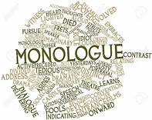
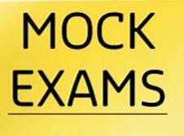
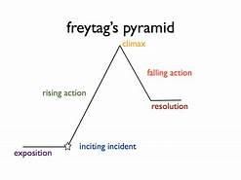
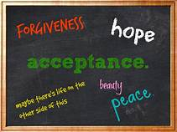
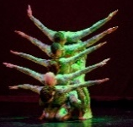
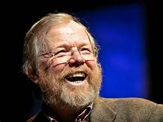
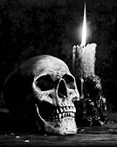
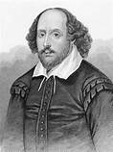
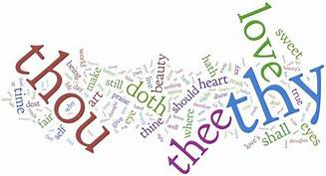
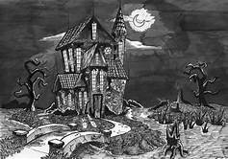
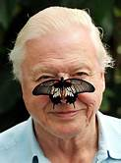
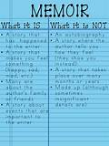
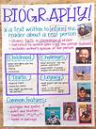
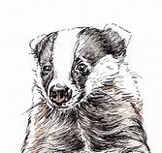
Independent and Imaginative Thinkers
Contextualisation
Knowledge
AOs
JSTC English Department: English Language
Five Year Learning Journey
Student Reflection:
How am I preparing for my English Language GCSE? Am I attending revision sessions or making time during independent learning time to adequately prepare?
Progression to next stage of learning:
A Level English Language
BTEC Scriptwriting
A Level Journalism
‘Student Focused Preparation. 10 Week Countdown’
GCSE PAPER 1 & 2
MOCK EXAM
Personal Development
Reflection
Confidence
Understanding of AOs
deconstructing texts; evaluating and comparison of two texts
‘Edexcel Language Paper 2’
GCSE PAPER 2
AO1, AO2, AO3, AO4, AO5, AO6 MOCK EXAM
Student Reflection:
How will I ensure that the choices I make in Y11 will support my academic development?
SLE to be completed on a topic of choice. Class teachers may guide students to complete on a Literature text
AO7, AO8, AO9
Honesty
Bravery
Confidence
Assessment Mock Feedback will be conducted in a whole department style following the Mock Exams
‘Completion of the SLE’
GCSE SLE (F, P, M, D)
‘Edexcel Language Paper 2’
GCSE PAPER 2
11
Fiction and Non Fiction 19/21st
Assessment Question: Students will complete a Paper 2 Mock in Y10 Summer Term. This is devised on the whole school calendar
Assessment Question: Jane Eyre Paper 1 Reading excluding evaluation
Monologue
Devising a speech
Control
Resilience
Reflection
Confidence
Courage
Curiosity
Respect
Feedback
AO1, AO2, AO4, AO5, AO6
MOCK EXAM
Introduction to the English Language specification and how this is underpinned by specific AOs
Understanding
Fiction,
Language & Structure
Evaluation
‘Edexcel Language Paper 1’
GCSE PAPER 1
10
‘Edexcel Walkthrough’
GCSE PAPER 1
Personal conflict
Inner emotion
SLE Opportunities: Spoken Language Practice
Students should begin developing a spoken piece for the SLE. Monologue workshop appropriate here
Confidence,
Personal Management
Resilience
AO1, AO2
19th Century Literary Fiction
Freytag’s Pyramid
Writing to entertain
‘Narrative Writing’
GCSE PAPER 1
SLE Opportunity: Acceptance
Students to practice speech writing and performances through explicit Literature teaching
Reflection
Deliberation
Respect
Assessment Question: Students to complete a narrative baseline before completing a 10 week narrative walk through
Reflection
Kindness
Hope
PSHE
Travel outside Lincolnshire
AO1, AO2, AO3
‘Diversity, Difference and Acceptance’
INTRODUCTION
‘Diversity, Difference and Acceptance’
MASTERY
9
SLE Opportunity: Good or Bad?
Students to persuade or discourage their class teacher to travel to a destination
of choice.
‘Fantastic Adventures’
MASTERY
Non Fiction
Choral Movement
Persuasive Styles
Social and Historical context
AO1, AO2, AO5, AO6
Assessment Question: Reading and introduction of 7a/7b
Solidarity
Compassion
Diversity
Difference
Assessment Question: Paper 1 style writing narrative focus on building tension through horror.
AO1, AO2, AO3
Building a thematic narrative – Freytag’s Pyramid
History – 19th Century Britain
Exploration of culture
‘Fantastic Adventures’
INTRODUCTION
‘Tales of Terror’
MASTERY
Trust, confidence,
self control
Non Fiction
SLE Opportunity: To fear or not to fear!
Students to devise a frightening narrative and share with their peers – adopting tone, style and register
Love of learning
Sense of humour
Theatre Play
Confidence
Introduction to Elizabethan audiences and societal difference
AO5 AO6 Narrative Structure
‘Tales of Terror’ INTRODUCTION
Determination
Compassion
Integrity
Trust
Modern VS Elizabethan
Introduction to Drama
Assessment Question: Write an open letter to the community persuading them to donate to the RSPC
AO1, AO2, AO5, AO6
‘Shakespeare’s Magic’
MASTERY
8
‘Natural Wonder’
MASTERY
‘Shakespeare’s Magic’ INTRODUCTION
Overcoming fear
Bravery
Resilience
Acceptance
Writing to Argue
Text exploration
‘Natural Wonder’ INTRODUCTION
SLE Opportunity: Stand with me!
Students to have the opportunity to speak to an audience with a purpose to persuade.
Assessment Question: Create a newspaper article concerning a Shakespeare play
Assessment Question: Write about a frightening experience
Trust
Bravery
Challenge
Determination
AO1, AO2, AO5, AO6
Writing for Purpose
Elizabethan Language
Narrative Writing
AO5, AO6, AO1, AO2
Understanding of Language
7
Environmental issues and Global concern
‘Writing from Life’
MASTERY
‘Writing from Life’
INTRODUCTION
Article Writing
Letter Writing
Persuasion
Overcoming prejudice and Belonging
Solidarity
Compassion
Respect
Kindness
Patience
Forgiveness
Autobiography, memoir etc
SLE Opportunity: Who am I?
Students to have the opportunity to share experiences since joining JSTC. Students to undertake workshops with class teachers and create a presentation of their memoir.
AO5, AO6, AO1, AO2
AO1, AO2, AO5, AO6
Assessment Question: Write about a time you were pleased about something.
Acceptance and inclusion
Confidence, resilience

