Slide 1
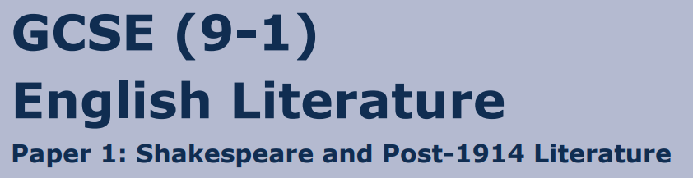
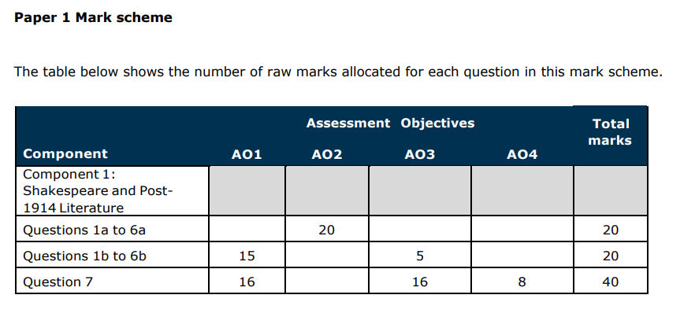
Easter School Revision Session
English Literature Paper 1

Slide 2
Session One: Literature Paper 1 AM Lessons
Shakespeare: Question 3a and 3b
Learning Focus: Explore the ideas conveyed by Shakespeare
https://www.youtube.com/watch?v=sj0LpiU-dVQ&list=PLA78A2-yUO6_6I5nuqEqWQ7Pc329LkXD2&index=6
https://www.youtube.com/watch?v=0lPUtwhKTJE&list=PLA78A2-yUO6_6I5nuqEqWQ7Pc329LkXD2&index=1
https://www.youtube.com/watch?v=ofX_ytQ4AcY&list=PLA78A2-yUO6_6I5nuqEqWQ7Pc329LkXD2&index=2
https://www.youtube.com/watch?v=6sGeWMCXUHA&list=PLA78A2-yUO6_6I5nuqEqWQ7Pc329LkXD2&index=3
https://www.youtube.com/watch?v=dao4kG4YSuw&list=PLA78A2-yUO6_6I5nuqEqWQ7Pc329LkXD2&index=4
https://www.youtube.com/watch?v=YFrFePKJKVU&list=PLA78A2-yUO6_6I5nuqEqWQ7Pc329LkXD2&index=5
https://www.youtube.com/watch?v=5iFtIrnNsSI&list=PLA78A2-yUO6_6I5nuqEqWQ7Pc329LkXD2&index=7
Watch all of the short video clips and create a mind map on A3 paper of what you learn. You will need this within the next activity

Slide 3
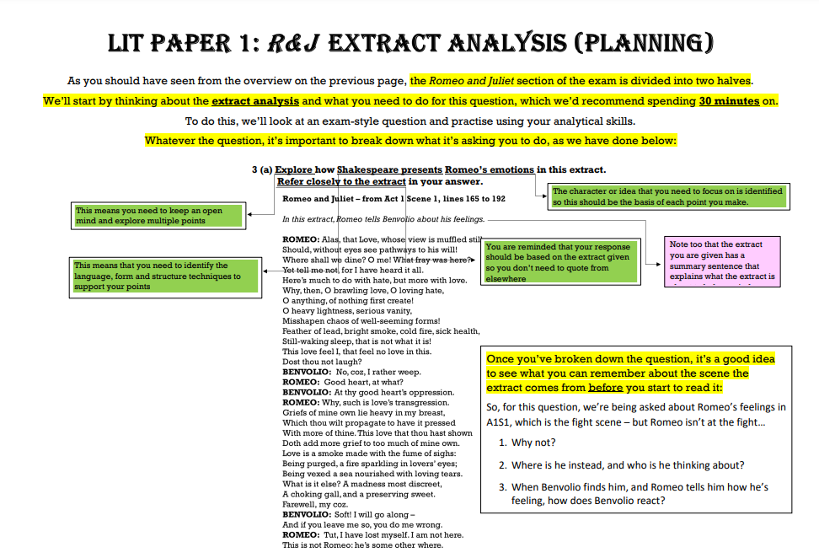


Slide 4
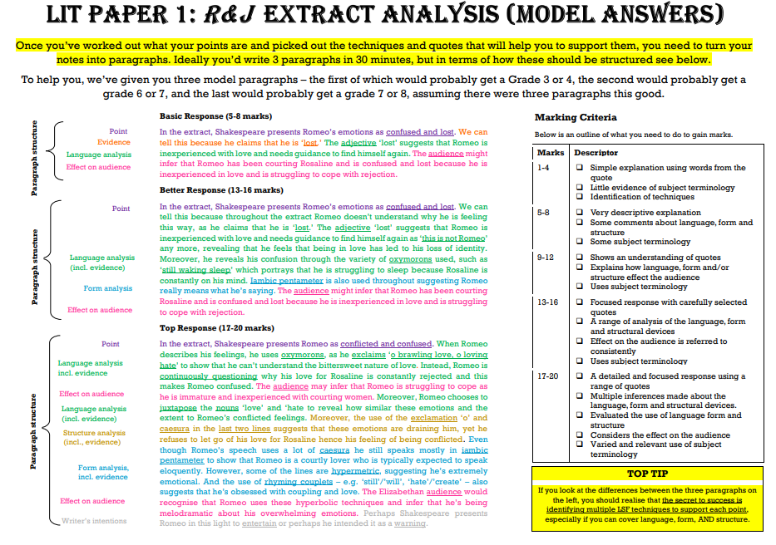

Slide 5
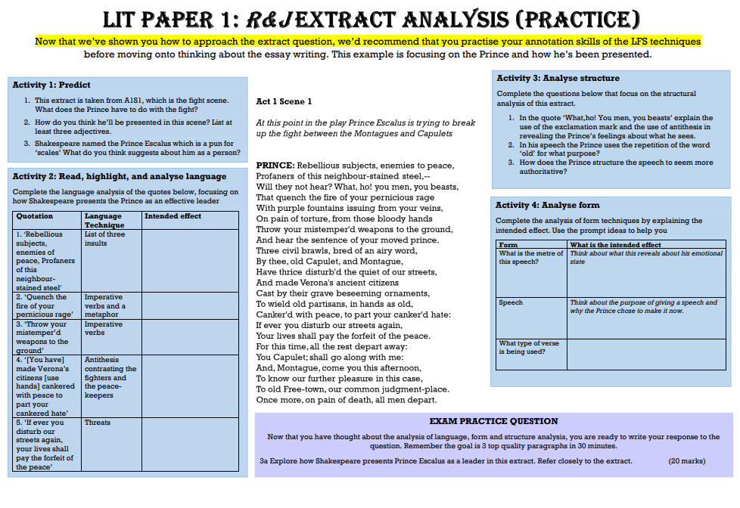


Slide 6
There are multiple questions you can attempt; some of these you can continue to do at home.

Slide 7
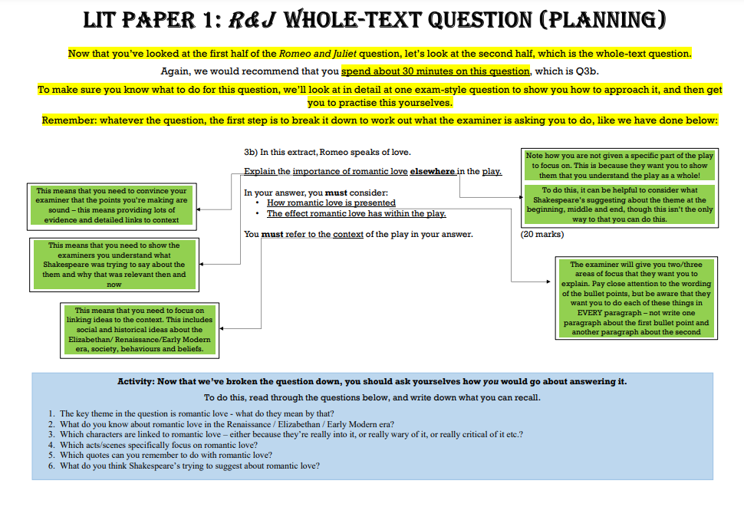

Slide 8
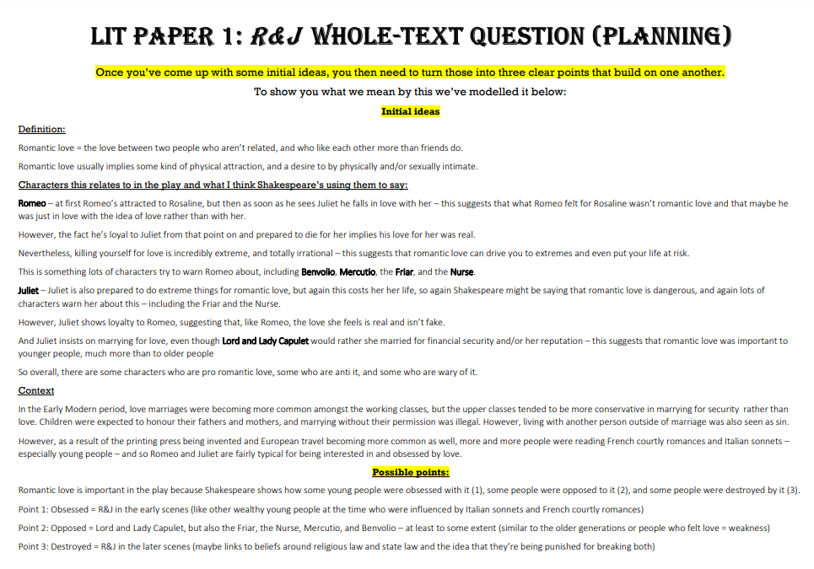

Slide 9
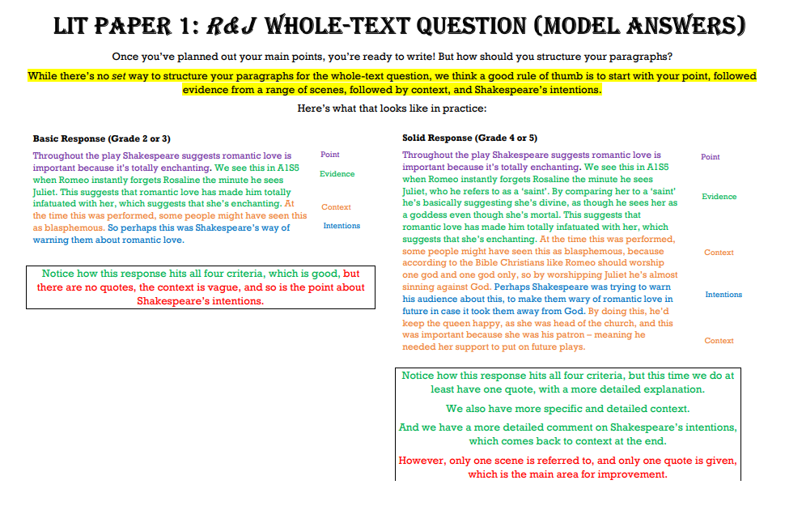

Slide 10
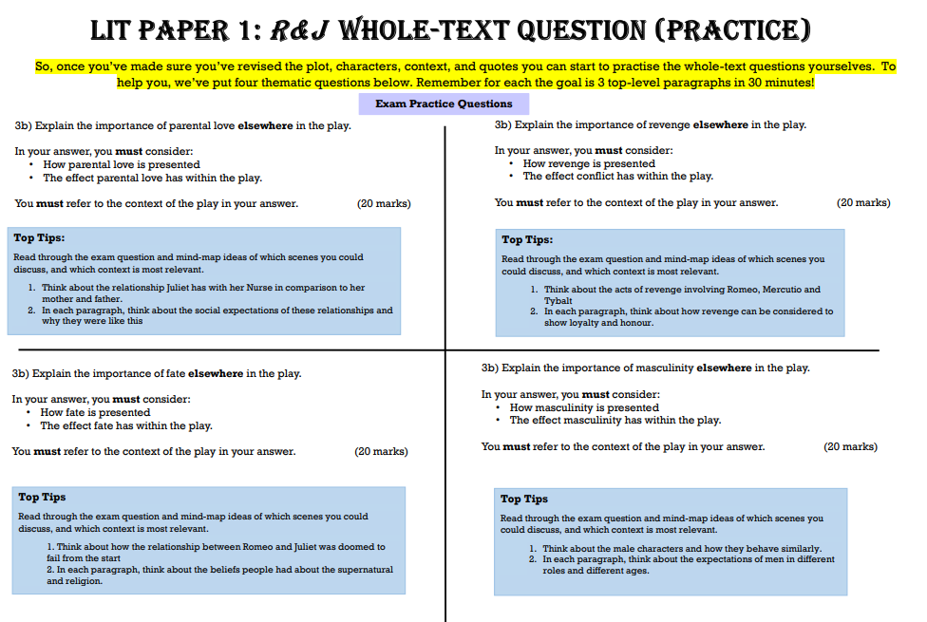

Slide 11
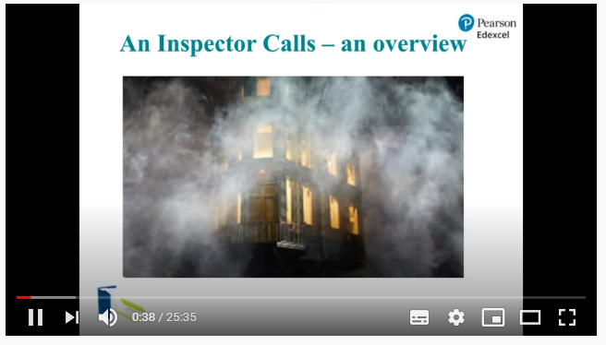
Session Two: Literature Paper 1 AM Lessons
An Inspector Calls
Learning Focus: Explore the ideas conveyed by Priestley
https://www.youtube.com/watch?v=zuUkrhgVYnQ
For session two, you are going to complete a LIVE lesson on An Inspector Calls. You need your booklet for this task

Slide 12
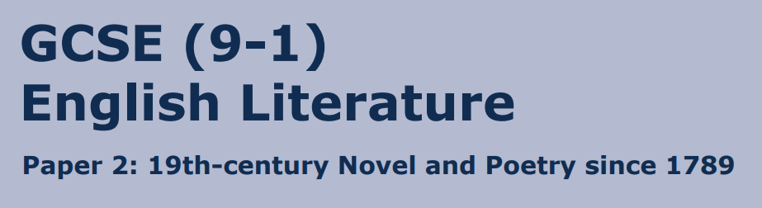
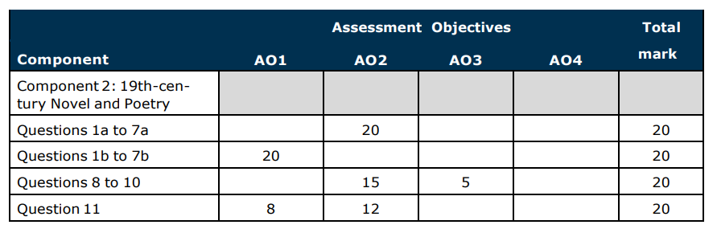
Easter School Revision Session
English Literature Paper 2

Slide 13
Session Three: Literature Paper 2 PM Lessons
Jekyll & Hyde Essay
Learning Focus: Explore the ideas conveyed by Stevenson
Section A: The 19th Century Novel
Extract/ Essay – 20/25 minutes each
https://www.youtube.com/watch?v=USY7YSVDNVY (plot summary)
Note: extract is AO2 only (language and structure methods) and must focus on the section of text on the exam paper only – you must use direct quotes to support
Essay is AO1 only (no AO2/AO3) and should focus on the novella as a whole (but not the extract)

Slide 14
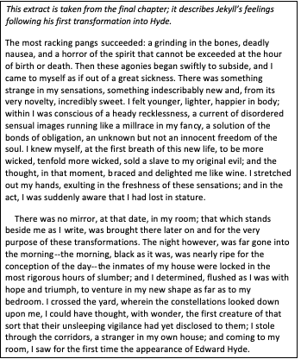
Session Three: Literature Paper 2 PM Lessons
Jekyll & Hyde Essay
Learning Focus: Explore the ideas conveyed by Stevenson
https://www.youtube.com/watch?v=XPXtgQbywMY
https://www.youtube.com/watch?v=yk51H0Mb8DY
Mr Bruff on Duality
Mr Bruff Student exemplar
Section A: The 19th Century Novel
Extract/ Essay – 20/25 minutes each
We have already covered the extract question: How does Stevenson present Jekyll in this extract?
We will now focus on the essay question:
In this extract, there is a focus on duality.
Explain how duality is shown elsewhere in the novella? (20 marks)
Watch the video clips above and use the resources to plan your answer to this question

Slide 15
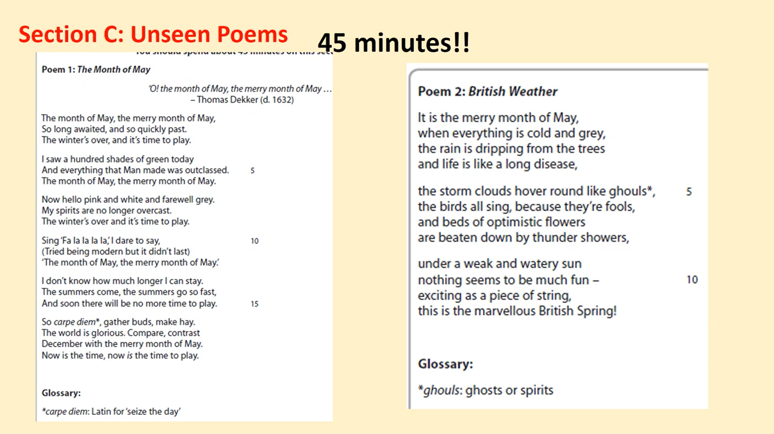
Session Four: Literature Paper 2 PM Lessons
Unseen Poetry
Learning Focus: Compare two poems within the conflict cluster
https://www.youtube.com/watch?v=3mPO39tZ_KQ (Play from 39 mins)
Watch the short video clips and create a mind map on A3 paper of what you learn. You will need this within the next activity

Slide 16
Session Four: Literature Paper 2 PM Lessons
Unseen Poetry
Learning Focus: Compare two poems within the conflict cluster
Compare how the writers present the May spring time in the two poems

