Slide 1

Welcome to our new Year 7 students and families
Mr S Curtis - Headteacher

Slide 2
Our Partnership
We Will:​
Work hard to know your child and get the best from them​
Encourage positive attitudes and participation in and out of the curriculum​
Ensure lessons are planned for progression and challenge​
Ensure you have communication routes with school and keep you informed​
Set relevant and meaningful home learning
Develop independence

Slide 3
Our Partnership
We ask our families to:​
Support the school policies and processes
Set up routines for preparation, uniform standards and home learning​
Read information from school and respond as appropriate​
Understand the secondary school working day​
Encourage positive attitudes and participation in and out of the curriculum​
Maintain the adult perspective – even when dealing with teenagers ​
Develop independence

Slide 4


Our Partnership

Slide 5
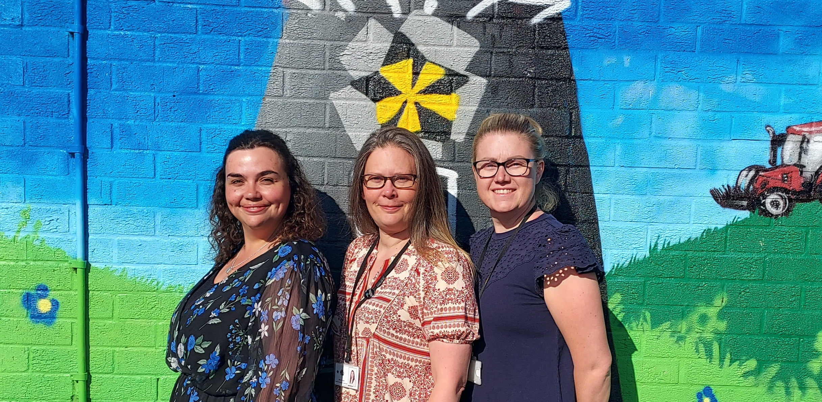
Year 7 Progress and Pastoral Team
AA

Slide 6
Year 7 Student Voice
Bella, Leo, Isiah, and Poppy.
AA

Slide 7
Mrs Appleyard
Assistant Headteacher
Curriculum; Supporting Disadvantage and Intervention

Slide 8
Our curriculum is designed to challenge students to achieve, individual excellence and to be the vehicle for delivering deep social justice. We are fiercely ambitious, and our curriculum reflects this passion and to embed the school ethos of respect, responsibility and resilience in the character of our students.​

Slide 9
Year 7 Curriculum
Five one hour lessons per day
A two week timetable
English – 7 lessons Maths – 7 lessons
Science – 6 lessons Art – 2 lessons
Drama – 2 lessons Music – 2 lessons
Spanish – 4 lessons History – 3 lessons
Geography – 3 lessons Computing – 2 lessons
Physical Education – 4 lessons Design Technology – 4 lessons
Religious Studies – 2 lessons PSHE – 2 lessons
Plus a broad range of cultural enrichment opportunities, including Enrichment Week, Camp, trips, external speakers and Reward visits

Slide 10
Intervention & Supporting Disadvantage
An Intervention is anything we, as a school, do to bridge a gap in learning and ensure every child makes progress.
This may take the form of:
Academic Intervention, such as English or Maths
Mentoring, to help students reach personal targets
Coaching, to create a culture of responsibility
Reading programmes
Specialised Intervention, specific to need

Slide 11

Extra-curricular opportunities
To support our in-class curriculum, we encourage students to participate in extra-curricular activities.
As well as the fantastic sports teams and fixtures, run by our amazing PE dept, there are a range of clubs and groups to be a part of within our school community.
Student Learning Leaders
Chess Club
Homework club
Art Club
Japanese Club
Spanish Culture Club
Photography club
To name but a few…!
RNO

Slide 12
Miss Norton
Deputy Headteacher- Behaviour and Rewards

Slide 13
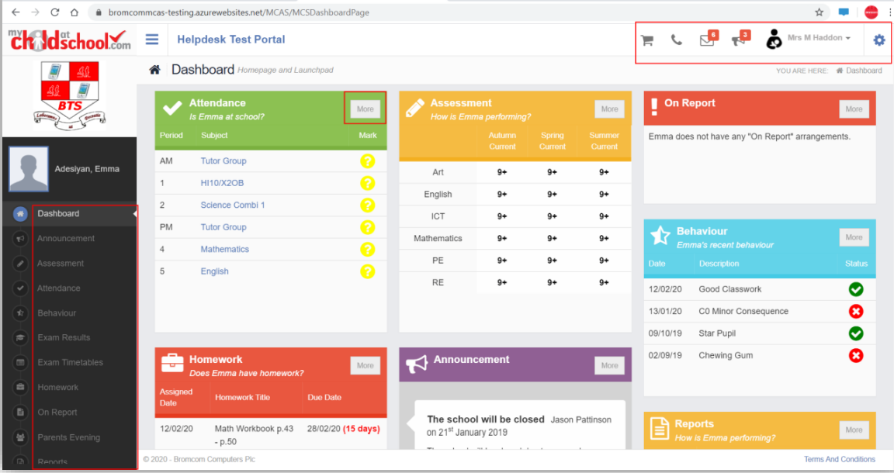
MyChildAtSchool (MCAS) App

Slide 14
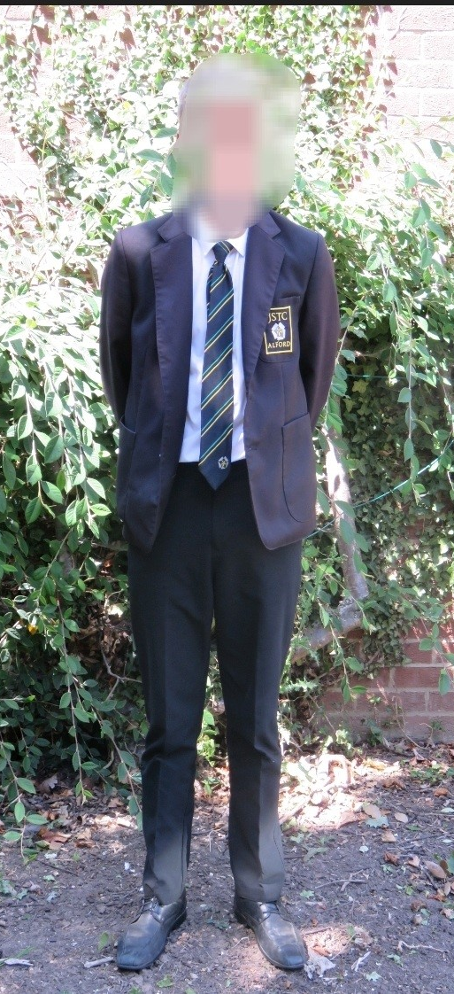
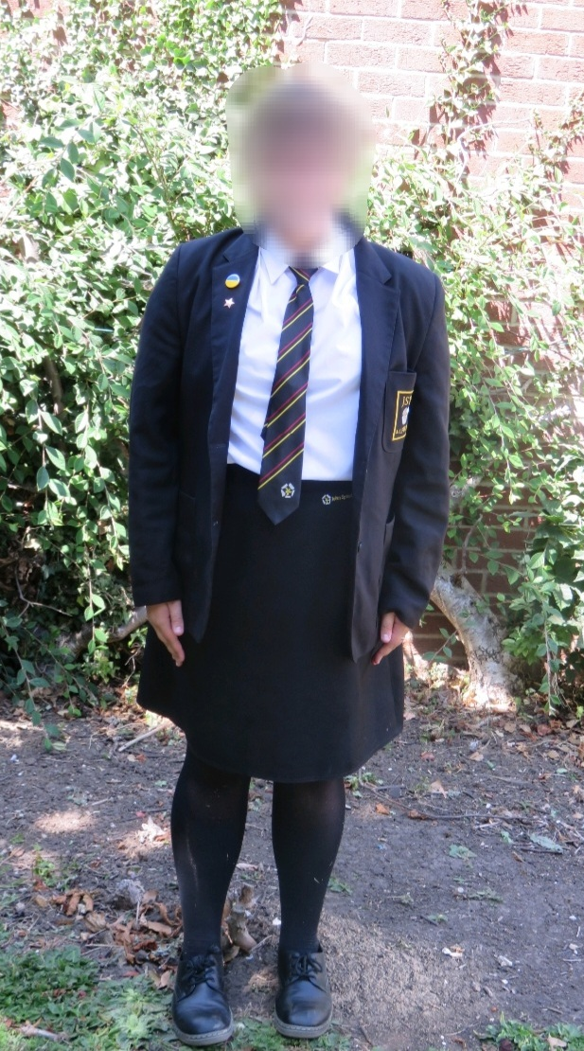
Uniform at JSTC
School blazer (with logo)
White shirt
Tie (with House colour)
Optional school jumper (*must be a black V-neck, with no logo's, unless wearing the school logo)
Traditional / slim fit black trousers
or Black knee length skirt
(with logo)
www.NationwideSchoolUniforms.co.uk
Pre-loved items at Alford Hub

Slide 15



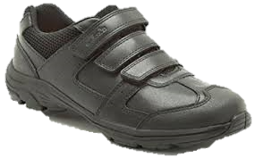

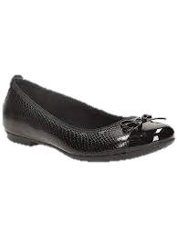







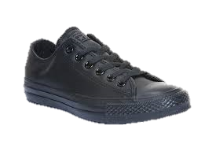
Uniform at JSTC
School Shoes
Formal smart leather / leather type shoes only,
Examples of acceptable footwear
Appearance
Make-Up - No make-up allowed.
Additional cosmetic items - No false eyelashes, no false nails, no nail varnish.
Hair - Hair colour should be natural. No extreme hairstyles.
Jewellery – Two studs and one small nose stud allowed. No other jewellery allowed.
Examples of unacceptable footwear
Trainers, boots, rubber soled shoes, canvas shoes/pumps are not allowed.
PF

Slide 16
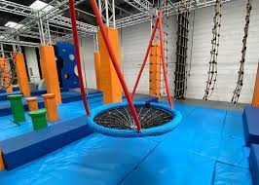
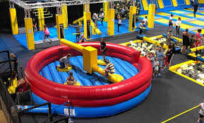

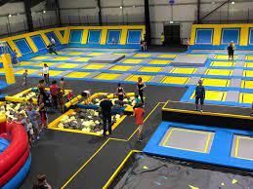
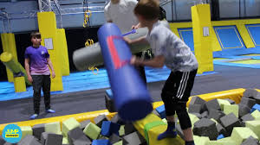

Slide 17
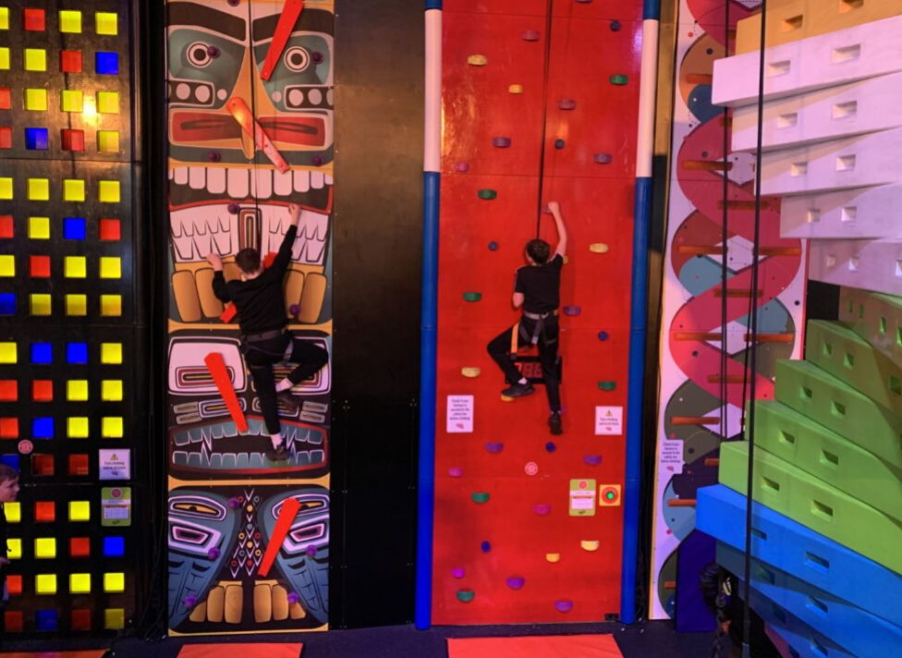
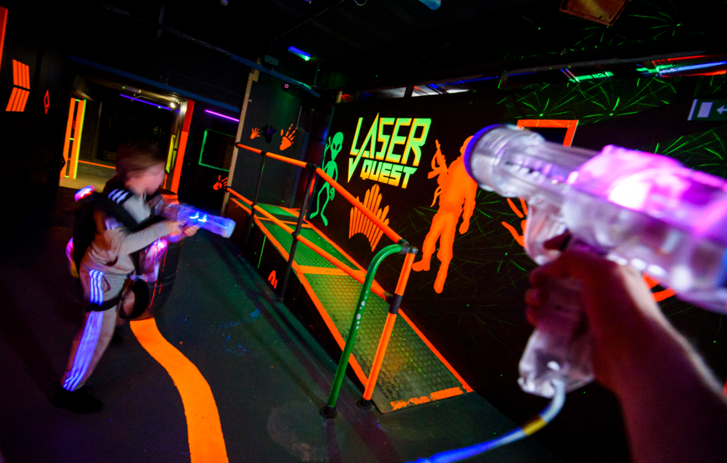
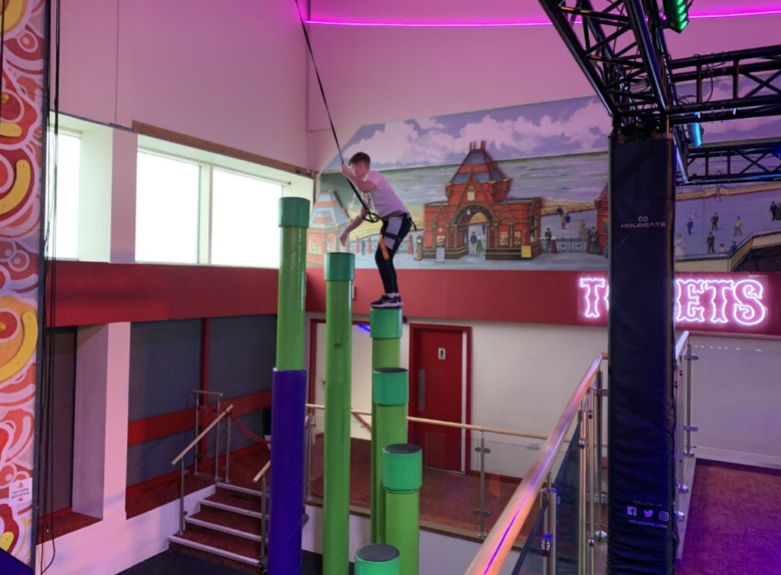

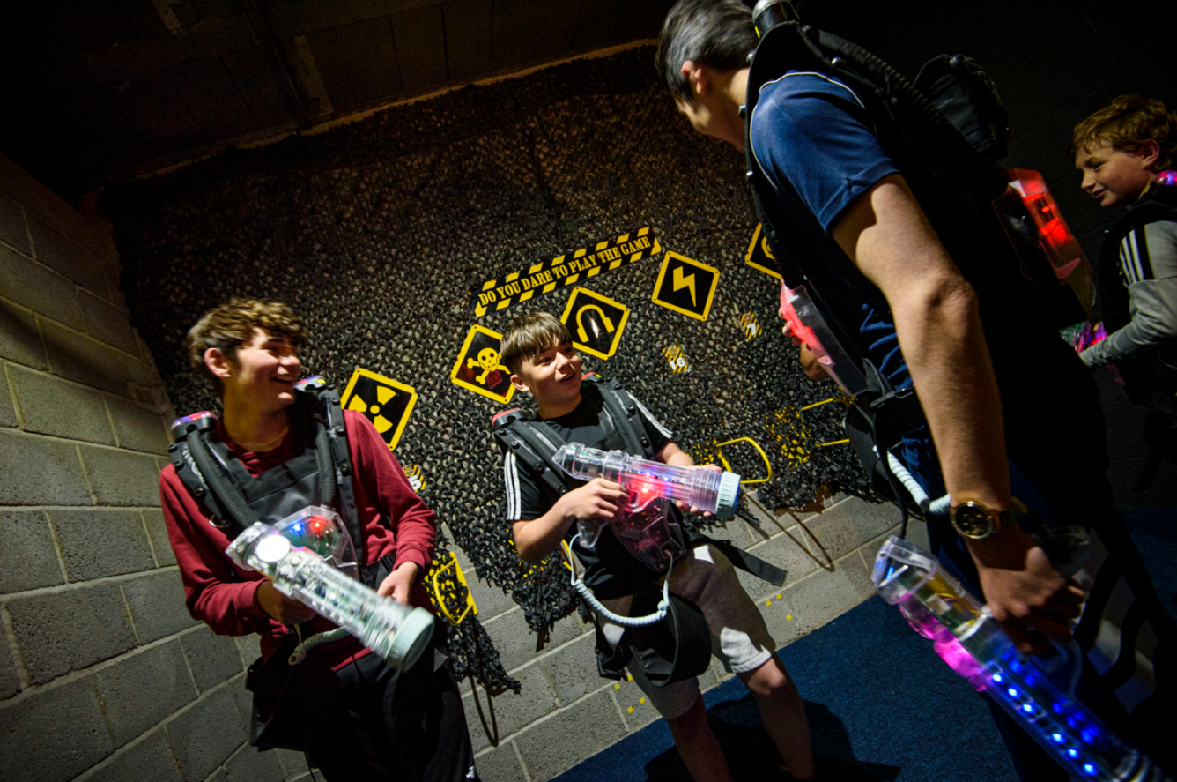
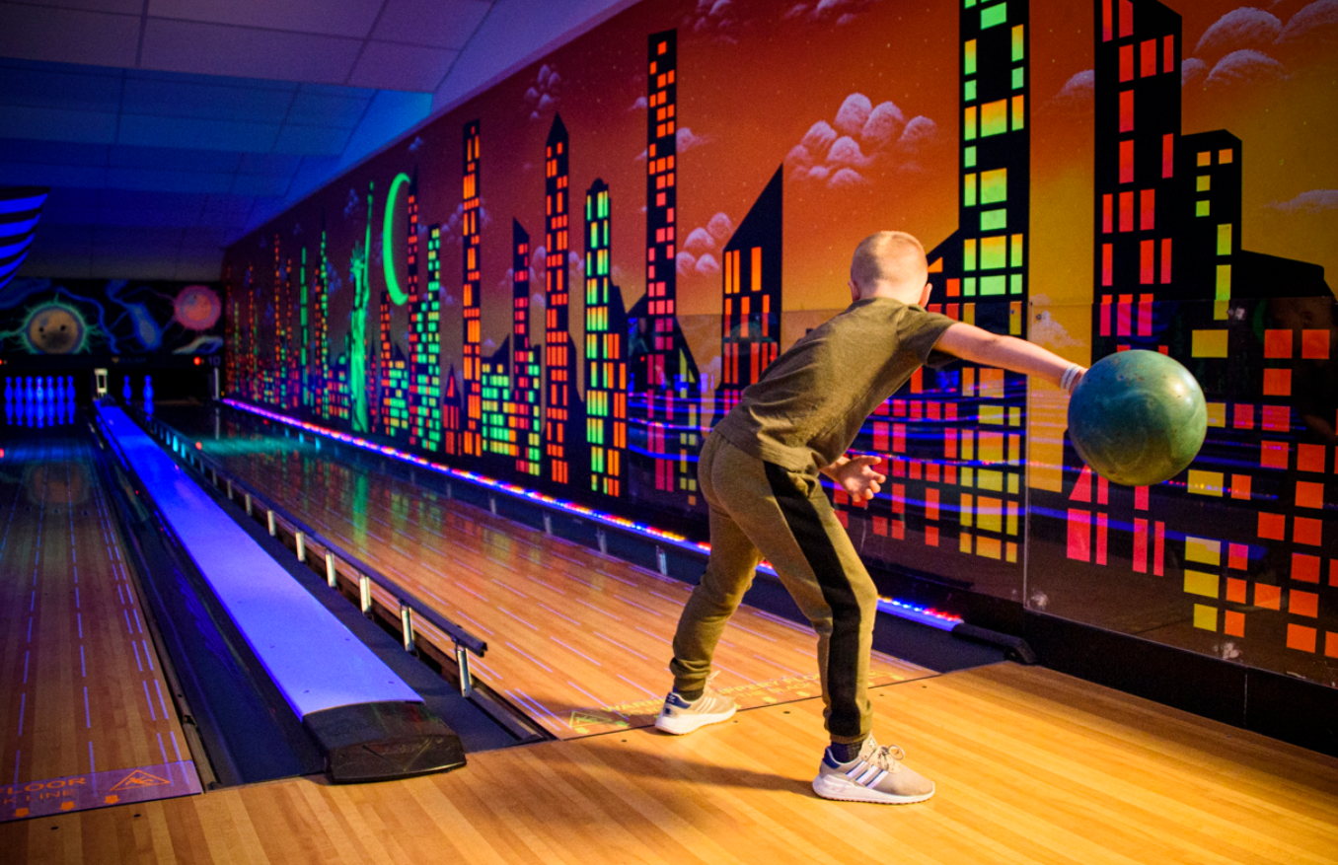
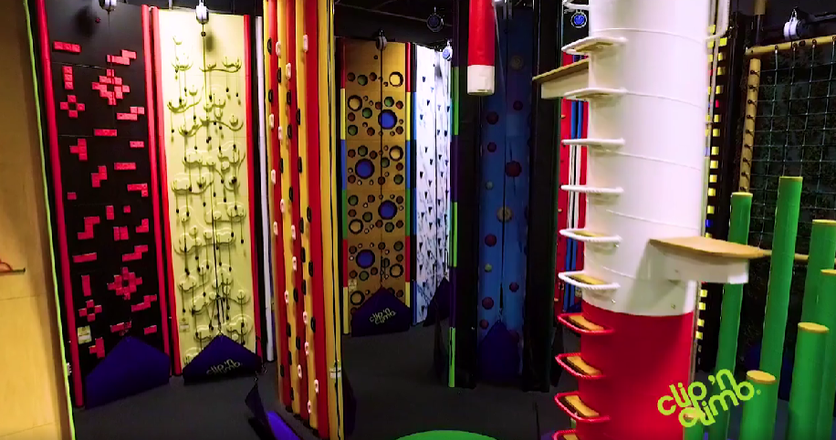
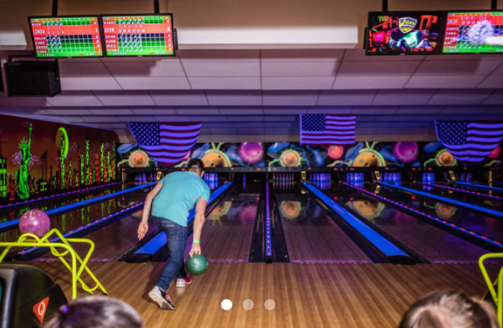

Slide 18



Who will be chosen to attend the trips?
Your behaviour points will be reset this term
Behaviour points = Positive points – Negative points
Tom
Positive points = 80
Negative points = 30
Tom’s Behaviour points = 50
Emily
Positive points = 60
Negative points = 5
Emily’s Behaviour points = 55
Your attendance percentage will also reset this term
EVERYONE HAS THE SAME STARTING POINT

Slide 19
Who will be chosen to attend the trips?
There will be 40 to 50 students chosen to attend based on:
      Highest behaviour points in the year group
      Top attendance
      *Most improved*
Progress Teams/DHT/HT make the final decisions
EVERYONE HAS THE SAME STARTING POINT

Slide 20

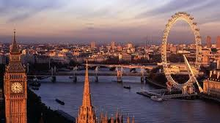




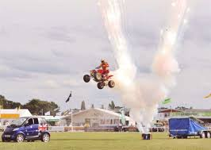

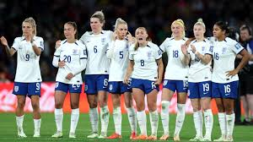

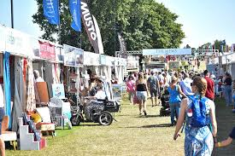
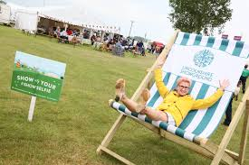


Additional Trips and Visits
There are additional trips and visits organised over the year. The same criteria applies for students to be able to attend these trips.
LA

Slide 21
Mrs Arrowsmith
Deputy SENDCo

Slide 22
FAQ
My child is on register at primary, will they be on register here?
What support will you offer my child?
What does support look like?
Who will work with my child?
Who can I contact about SEN?
I think my child needs more support than they had at primary, what do I do?
Where can I get help with my child?
RT

Slide 23
Safeguarding and Prevent Dept
@ JSTC Alford
Mr Robert Thornalley Assistant Head teacher &DSL
Mrs Karen Paice Deputy DSL
Our priority as a team of professionals is to support, care for and keep your child safe.
Every member of staff is trained to high level in safeguarding.
We use a new modern MIS reporting system to record and monitor all safeguarding interactions.
As a team we work closely with families and outside agencies when required to provide the best care and guidance for our students and for you as families.

Slide 24

Miss Hannah Elias Online -E Safety
The Internet is written
in PEN, not pencil
Social Media
Teenagers tend to have a reckless, impulsive approach to social media. That’s why it’s important to think first before you post what you are thinking or feeling. Even though you can delete something (a post, picture, comment, etc.) you can never permanently erase something that has been published on the internet (even Snapchat posts are stored for 9 months!). Face your problems- don’t Facebook them!

Slide 25

What is E-Safety?
What do we do at JSTC to support this?
E-Safety concerns safeguarding children and young people in the digital world, which emphasises learning to understand and use new technologies in a positive way.
E-Safety is also about informing young people where to seek help and advice on e-Safety issues and reporting.
Educate our students through PSCHEE lessons, using the KCSIE framework.
Host assemblies to support and guide them on how to interact online.
Support and visits from external agencies when educating our students on relevant concerns and topics.
Notes:
E-Safety concerns safeguarding children and young people in the digital world.
E-Safety emphasises learning to understand and use new technologies in a positive way.
E-Safety is less about restriction and more about education of the risks as well as the benefits, so we can feel confident online.
E-Safety is concerned with supporting children and young people to develop safer online behaviours both in and out of school.
E-Safety is also about informing young people where to seek help and advice on e-Safety issues and reporting.

Slide 26
Screen addiction
Kids are gaining access to devices when they are very young
98% of children from newborn to age 8 have access to a mobile device at home, compared with 52% in 2011. (Common Sense Media 2017. The Common Sense Census: Media Use by Kids Age Zero to Eight)
94% of teens age 13 to 17 own or have access to a smartphone and use social media (April 2017 study by The Associated Press-NORC Center for Public Affairs Research)
https://committees.parliament.uk/writtenevidence/89016/html/
https://publications.parliament.uk/pa/cm5804/cmselect/cmeduc/118/summary.html
https://pmc.ncbi.nlm.nih.gov/articles/PMC11049253/

Slide 27
Screen addiction
Half of teens feel addicted to technology and social media
1 out of every 2 teens feels addicted to their smartphones and the majority of parents (60%) feel their kids are addicted. (Common Sense Media 2016. Dealing with Devices: The Parent-Teen Dynamic)
78% of teens check their devices at least hourly. (2016 Common Sense Research. Technology addiction: Concern, controversy, and finding balance)
72% of teens feel the need to immediately respond to texts, social networking messages, and other notifications. (2016 Common Sense Research. Technology addiction: Concern, controversy, and finding balance)
77% of parents feel their child gets distracted by his or her devices and doesn’t pay attention when they are together at least a few times per week. (2016 Common Sense Research. Technology addiction: Concern, controversy, and finding balance)
Half of parents (50%) say they are at least "somewhat" concerned that their children's mobile device use is negatively affecting their mental health; nearly one in five parents (18%) say they are "extremely" or "very" concerned (Common Sense Media, 2018)
https://committees.parliament.uk/writtenevidence/89016/html/
https://publications.parliament.uk/pa/cm5804/cmselect/cmeduc/118/summary.html
https://pmc.ncbi.nlm.nih.gov/articles/PMC11049253/

Slide 28
So how does this work at JSTC?
“off and away!”
Food and Phone Zone
BROMCOM – our MCAS system
Please use our main office

Slide 29

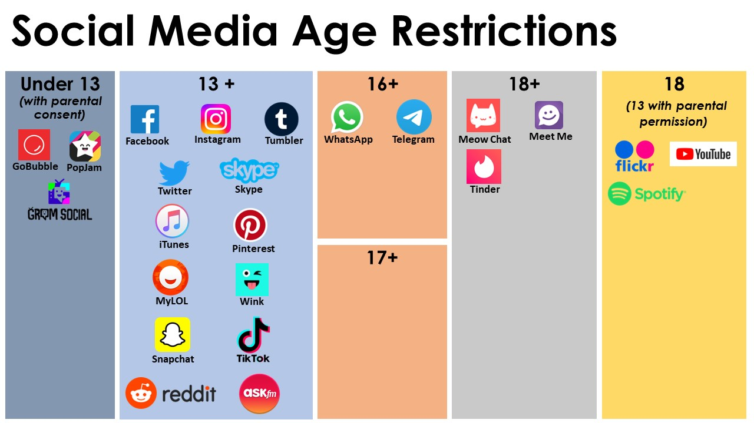
SDC

Slide 30
Expectations of Learning Behaviour
Come equipped to learn
Bring your bag with your own equipment to every lesson: pen, highlighter, ruler, pencil, rubber, and pencil sharpener in a pencil case.
Bring a reading book every day. Some lessons begin with silent reading.
High standards of work, presentation of uniform and learning behaviour
There should be no doodling or graffiti on your exercise books or folders or paper. You may be asked to pay if school property is lost or damaged. If you need to doodle to help with your concentration, scrap paper is available.
Write in black / blue pen. You cannot use other colours in final examinations. Your teachers will explain the standards of work presentation at the start of term.
Homework or independent learning will be set by your teachers and will need to be completed by the deadline set. We don’t want ‘my dog ate my homework’ excuses! Online platforms are used by many departments; the benefit of this is that you receive instant feedback...and so do we!
There are lots of staff who can give you help with your homework (they will help you but they won’t do it for you!). We have a lunchtime homework club or you can ask your teacher or learning support assistant for support – before the deadline though.
Show respect to everyone at all times
Be kind, polite and follow instructions straightaway
Make every second of every lesson count – your time here will go quickly ... you will be Year 11 in no time at all!

Slide 31
Mental Health and Wellbeing
John Spendluffe Technology College places a high value on the mental health and emotional wellbeing of all students in our care.
What is meant by ‘Mental Health’?
We all have mental health – whether it is good, bad or in the middle. Put simply, your mental health is the way you feel on any particular day.
According to the World Health Organization (WHO), mental health is ‘a state of well-being in which the individual realizes his or her own abilities, can cope with the normal stresses of life, can work productively and fruitfully, and is able to make a contribution to his or her community.’
Tutors, progress teams and all staff are here to support you and your wellbeing.
We work in partnership with the Mental Health Support Team, Lincolnshire NHS Trust, Skegness branch. We can refer students to this service. We also have in-school counsellors and in school mental health first-aiders.

Slide 32
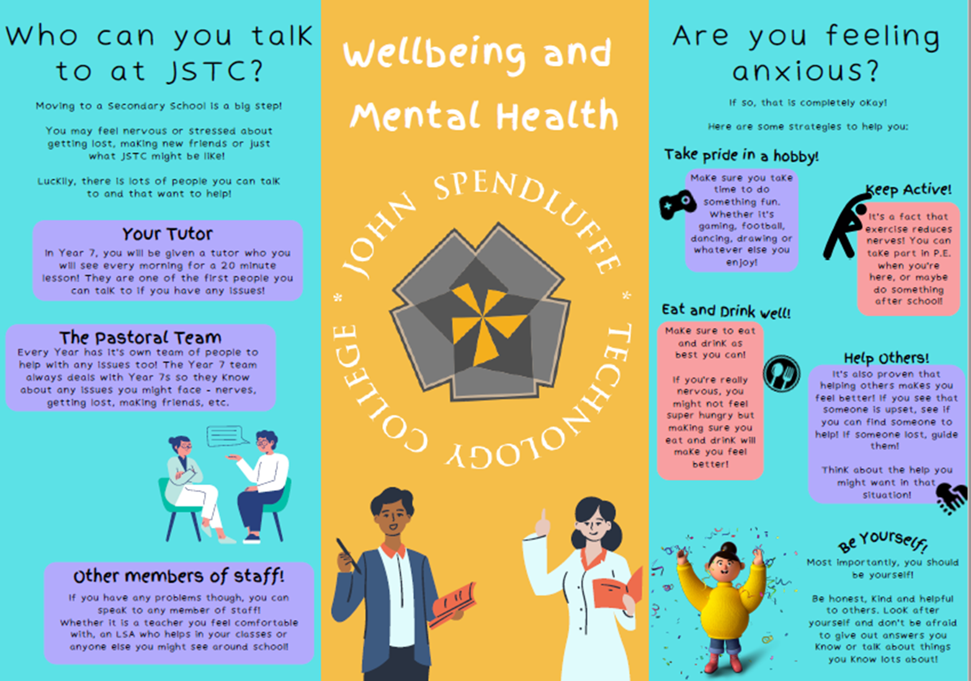

Slide 34

Your School needs you!
Parent Governor recruitment
Support the development of the school
Be a critical friend
Attend 6 meetings over the year (cake is provided)
Support and training provided
If you are interested or wish to know more please come and speak with me.

Slide 35
Key Dates
4th September- Year 7 First Day
9th October- Year 7 Settling in evening
December- Year 7 Progress Update
March- Year 7 Progress Update
30th April- Year 7 Parents evening
July- Year 7 Progress Update
Admin staff are available to help with admission forms.
ICT team are available to sign up for the Ipay system
This will take place in the Sports Hall.

