Slide 1
Year 11 GCSE Mock Examinations
31st October – 10th November

Slide 2
Year 11 Schedule
11.9.23 | 1
18.9.23 | 2
25.9.23 | 3
2.10.23 | 4
9.10.23 | 5 Engagement Evening
16.10.23 | 6
 | Half term
30.10.23 | Mock Exams 1
6.11.23 | Mock Exams 1
13.11.23 | Mock Exams 1
20.11.23 | 7 Parents Evening
27.11.23 | 8
4.12.23 | 9
11.12.23 | 10
18.12.23 | 11
 | Christmas
3.1.24 | 12
8.1.24 | 13
15.1.24 | 14
22.1.24 | 15
29.1.24 | 16
5.2.24 | 17
 | Half term
19.2.24 | 18
26.2.24 | Mock Exams 2
4.3.24 | Mock Exams 2
11.3.24 | 19
18.3.24 | 20 Parents Evening
25.3.24 | 21
 | Easter (Easter School)
15.4.24 | 22
22.4.24 | 23
29.4.24 | 24
6.5.24 | GCSE EXAMS
13.5.24 | GCSE EXAMS
20.5.24 | GCSE EXAMS
 | Half term
3.6.24 | GCSE EXAMS
10.6.24 | GCSE EXAMS
17.6.24 | GCSE EXAMS
 | Summer

Slide 3
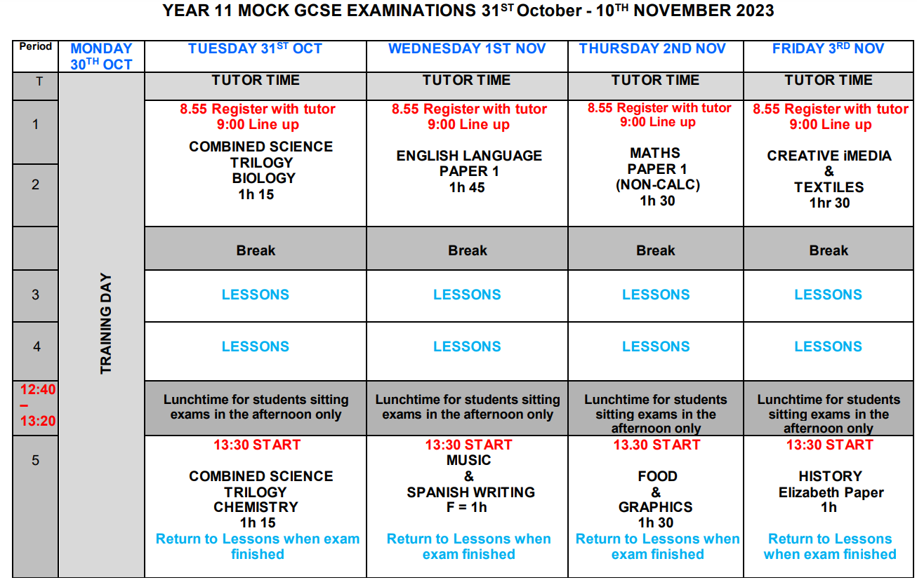

Slide 4
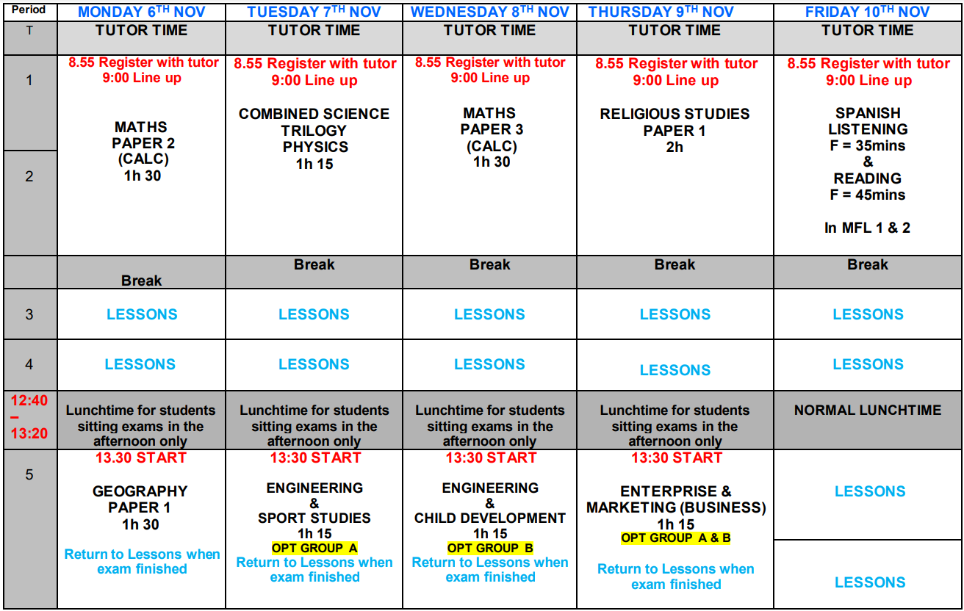
You must go back to your usual classroom once you come out of an exam.
Normal lunchtime and lessons if you are not in an exam

Slide 5
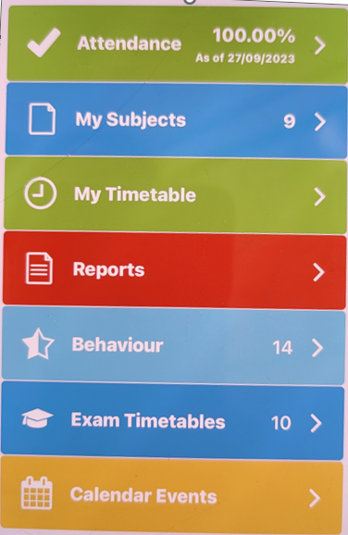
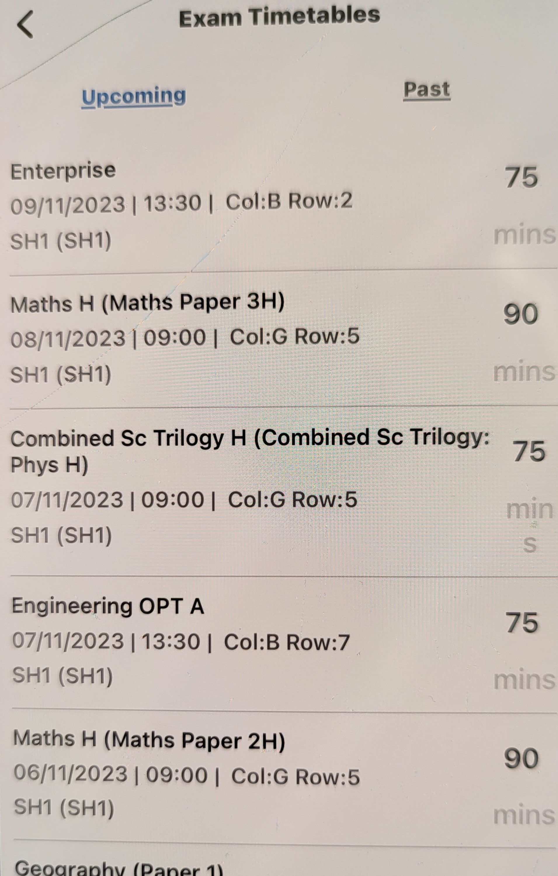
Bromcom

Slide 6
Morning Routine
8.55am prompt
Tutor room – Register, equipment, phone and watch
Bag store – Bag (coat inside bag recommended)
9.00am
Line up in the correct line in English Playground outside H3
(row A, B, C etc)
Listen to instructions

Slide 7
Attendance and Punctuality
You MUST be in your tutor room by 8.55am at the latest.
Attendance team will check the registers immediately and contact home for missing students.
If you are late, you run the risk of not being allowed to sit the exam.
If any exam is missed, your parents/carers will be invoiced for the cost of the exam.
Any unforeseen problems, contact the main office straight away.
Notes:
Discuss attendance team procedures
Also if they write little/nothing on their papers

Slide 8
Malpractice
To maintain the integrity of qualifications, strict Regulations are in place
Malpractice means any action or behaviour which is in breach of the Regulations
Any alleged, suspected or actual incidents of malpractice will be investigated and reported to the relevant awarding body/bodies
The Joint Council for Qualifications (JCQ) provides information regarding what constitutes malpractice:
Introduction of unauthorised material into the examination room
Breaches of examination conditions
Exchanging, obtaining, receiving, or passing on information which could be examination related (or the attempt to)
Offences relating to the content of candidates’ work
Undermining the integrity of examinations/assessments

Slide 9
Malpractice
Other examples of malpractice are:
Possession of a mobile phone or smart enabled device - even if switched off
Possession of a Watch
Talking/turning around/disrupting others
Possession of notes
Writing on hands/skins
Offensive Language
Writing/drawing obscene material
There are severe penalties for malpractice.
You could be disqualified from your exams.
Please check your pockets before you go into every exam

Slide 10
Consequences of Malpractice
If you are caught or suspected of committing malpractice, then an investigation will take place, we are obliged to report it to the Exam Boards and they will make the decision on sanction.
Written warning
Loss of marks for that paper
Loss of marks for that subject
Loss of marks for all exams with the that exam board
All exams cancelled for all exam boards
Banned from taking exams for 1-5 years
In 2019 1,560 students had their papers ‘zeroed’ due to malpractice.
46% of those were due to mobile phones

Slide 11
Mobile Phones and Watches
No watches, phones, ear buds or electronic items are allowed in the examination room – take off BEFORE entering the hall and leave in bag.
If you are found to be in possession of an unauthorised device during your exam, whether switched on or off, you are committing Malpractice and could result in you being disqualified.
Your pockets must be completely empty – put everything in your bag in the lockers.

Slide 12
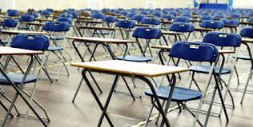
In the Examination Room
Once you have entered the exam room you are under exam conditions
This means that you cannot communicate in any way with any other Candidate
“Any malpractice, suspected or actual, from this point must be reported to the relevant awarding bodies”
Silence from when you enter to when you leave.
Sit down in your seat, face the front at all times.
Place your equipment on the desk.

Slide 13
In the Examination Room
Do not write anything on your paper until you are instructed to do so.
It is considered Malpractice if you do.
A candidate card will be on each exam desk. Do not write on or destroy the candidate card
Make sure you have used the toilet before you go into the exam room
Disturbing the exam room in any way could get you disqualified
Raise your hand if you have a question.

Slide 14
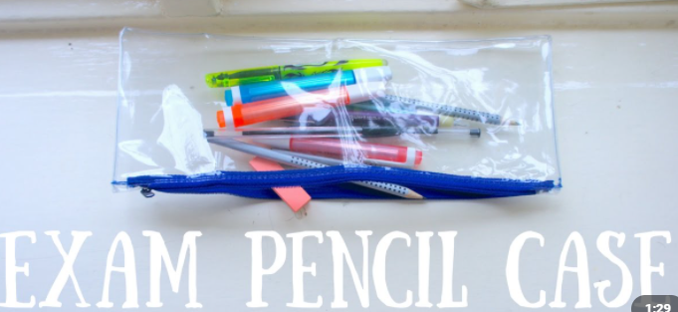
Equipment - Clear Pencil Case
Black pens Pencil Ruler
Protractor Compass Highlighter
Eraser Sharpener
Scientific Calculator
Make sure you have ALL equipment, you will not be leant any.
Bottles of water are allowed BUT it must be a clear bottle with no wrapper or writing

Slide 15
Invigilators
Members of JSTC staff.
Some will be new to you, but they are there to support you.
They are also there to maintain the integrity of the exam.
Their job is to give you the very best opportunity to concentrate and achieve your very best.

Slide 16
Exam Instructions
Listen to them. They will become familiar to you, but you must put your hand up if you think you have the wrong paper.
Final chance to hand over anything you shouldn’t have.
Pay attention to the instructions and the wording of the questions.

Slide 17
JCQ – Exams Handbook
You will get a copy sent home on Bromcom.
This is there to protect you. Don’t worry about this, we will talk you through what to do.

Slide 18
Your Answers
Must be in black pen.
You don’t have to answer the questions in order.
Leave space after each answer so that you can go back and add more.
Do not doodle or write daft comments. Your paper can be given zero for this.

Slide 19
When you leave
Quite often, others may still be working. Leave in silence until you get out and away from the building.
Be aware that students will be in ICT3 and other classrooms still completing the exam with extra time so don’t disturb them.

Slide 20
Fire Drill Reminder
When instructed, leave the exam venue in absolute silence.
Walk to the far side of the year 11 area and line up in silence.
When instructed, head back to your exam seat and continue.
It is vital that no words or communications are exchanged at any point otherwise you could jeopardise your exam.

Slide 21
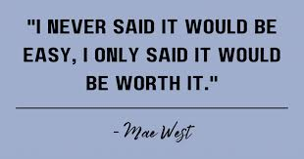
Final Words

